Slide 1
THE PSYCHOLOGY OF LEARNING
Prof. Dr. Jan De Houwer
Prof. Dr. Sean Hughes
Department of Experimental Clinical and Health Psychology
Ghent University
Email: Jan.DeHouwer@UGent.be

Slide 2
I. OBJECTIVES
1. Knowledge about learning psychology
- historical importance, also recent insights
- not the details, but the essence / introduction with references
2. Not just facts but also insights into the why of (learning) psychology: thinking about goals
= learning psychology as a heuristic framework with many applications

Slide 3
II. SUPPORT
1. Course text is essential:
- version 2020 (do not use older versions)
De Houwer, J., & Hughes, S. (2020). The psychology of learning: An introduction from a functional-cognitive perspective. The MIT Press. [CC-BY-SA]
- pdf on www.psychologyoflearning.be
- Chapter 0 is foundation

Slide 4
3. Additional literature for depth:
Bouton (2007, 2016), Learning and Behavior (PPW.08E.0029).
Catania (2013). Learning (^{5th} ed). ( PPW.04E .0012 )

Slide 5
INTRODUCTORY CHAPTER:
WHAT IS LEARNING AND
HOW CAN ONE STUDY LEARNING?

Slide 6
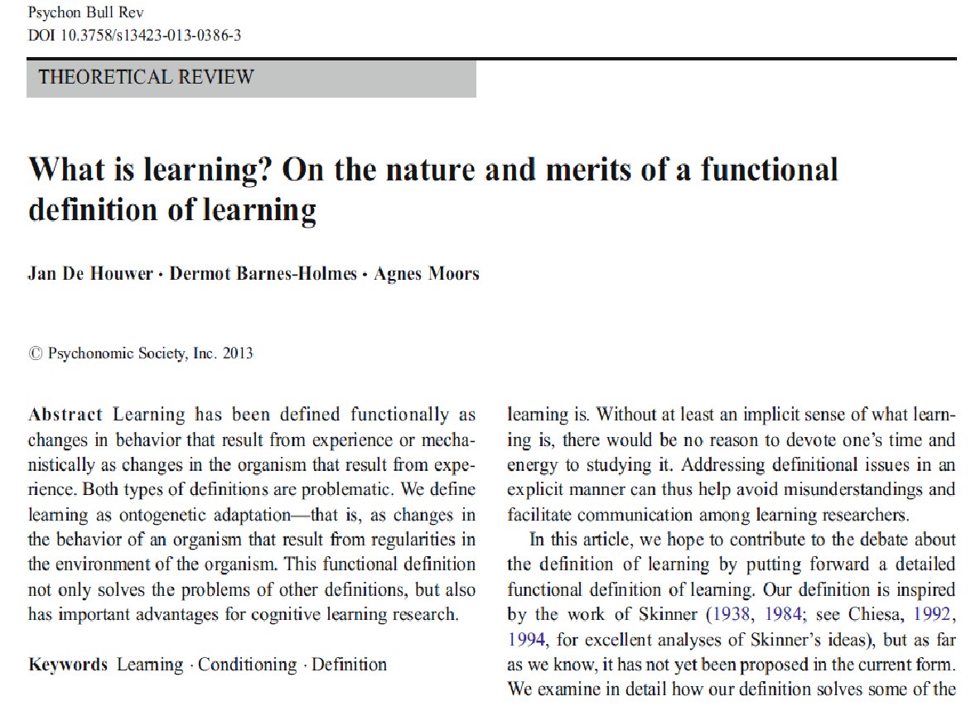

Slide 7
0.1. What is learning?
0.1.1. Learning as ontogenetic adaptation
Evolution (Darwin): Phylogenetic adaptation (adaptation to environment over generations, e.g., giraffe's neck, African-South American migration)
Learning: Ontogenetic adaptation (adaptation during the life of one organism).

Slide 8
Learning = observable changes in the behaviour of a particular organism during its life as a result of regularities in the environment
= ESSENTIAL within psychology
(like evolutionary theory is essential for biology)

Slide 9
0.1.2. Difficulties in applying the definition of learning
"Learning = observable changes in the behavior of a particular organism during the organism's life as the result of regularities in the environment"
environment is cause => is not an observation but a hypothesis about causes of behavior
(e.g. grip reflex) + see also "traffic death".
Learning = effect of environment (more specifically, regularity in environment) on behavior

Slide 10
0.2. Types of learning
0.2.1 Types of regularities / patterns in the environment
Regularity = anything more than 1 event at 1 moment in time (De Houwer et al., 2013)
- in the occurrence of 1 stimulus (e.g., food)
- in the occurrence of 2 stimuli (e.g., food on certain tree)
- in the occurrence of behaviors and stimuli (e.g., food when you shake the tree)

Slide 11
0.2.2. Types of learning
Traditionally 3 types:
- effects of a regularity in the occurrence of 1 stimulus (e.g., repeated bang => reduction in response)
= effects of non-contingent stimulus presentations
- effects of a regularity in the occurrence of 2 stimuli (e.g., relation bell-food => salivation to bell)
= classical conditioning
- effects of a regularity in occurrence of behaviour and stimuli (e.g., link pushing-food=> pushing more often)
= operant conditioning

Slide 12
- Complex learning = joint effect of multiple regularities
2 types of complex learning based on distinction between standard and meta-regularities
=> standard regularity: only individual stimuli and responses as elements (e.g., tone-shock)
=> meta-regularity: at least one regularity as an element

Slide 13
2 types of complex learning
- Moderated learning = joint impact of multiple standard regularities
E.g. Sensory pre-conditioning
Phase 1: Light - Tone
Phase 2: Tone - Shock
Test: Light => elicits fear

Slide 14
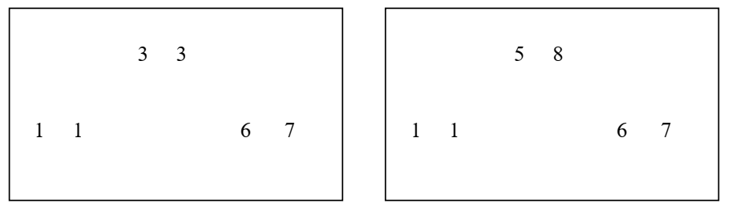
Effects of meta-regularities
Example: Relational matching to sample

Slide 15
Overview of learning types
Effects of non-contingent stimulus presentations
Classical conditioning
Operant conditioning
Complex learning
° moderated learning
° effects of meta-regulations

Slide 16
Exercise Question 1: If you say that learning has taken place, then you are claiming that
1. there have been changes in the brain
2. a regularity in the environment has an influence on behaviour
3. information is stored in semantic memory
4. rewards are offered
Notes:
🍐 This is a Pear Deck Multiple Choice Slide. Your current options are: A: changes have occurred in the brain, B: a regularity in the environment affects behavior, C: information is stored in semantic memory, D: rewards are offered,
🍐 To edit the type of question or choices, go back to the "Ask Students a Question" in the Pear Deck sidebar.

Slide 17
Exercise Question 2: Suppose a rat first experiences that a tone is always followed by food. Then it learns that pressing a handle is followed by food. If, after experiencing both phases, the tone is presented, the rat will push the handle. This change in behavior is an example of
Classical conditioning
Complex learning
Operant conditioning
Effects of non-contingent stimulus presentations
Notes:
🍐 This is a Pear Deck Multiple Choice Slide. Your current options are: A: classical conditioning, B: complex learning, C: operant conditioning, D: an effect of non-contingent stimulus presentation,
🍐 To edit the type of question or choices, go back to the "Ask Students a Question" in the Pear Deck sidebar.

Slide 18
0.2.3. Difficulties in determining type of learning
Distinction based on what is assumed to be the cause of change in behavior
- e.g. Pavlov's dog:
Behaviour: increase in salivation when hearing bell
* possible causes:
- repeatedly offering food
- BELL-FOOD
=> CONFOUNDS of different regularities so experimental research with controls is needed

Slide 19
Distinction procedure vs effect
Procedure = that which a researcher does: offering stimuli and observing behavior
e.g. Classical conditioning procedure
Effect = impact of regularity on behavior
(not directly observable)
e.g. Classical conditioning as an effect

Slide 20
0.3. A functional-cognitive framework for the Psychology of Learning
Two approaches in the psychology of learning that differ in their objectives
- Functional approach
B = f (Er)
- Cognitive approach: Mental processes that influence behavior

Slide 21
0.3.1. Functional approach
0.3.1.1. Environment as moderator of learning
Learning (impact of Er on B) depends on / is moderated by characteristics of the environment
e.g.: Effect of “pushing lever – food” depends on how long the rat has not eaten.
Aim: To discover moderators of learning: What aspects of the environment determine the impact of Er on B?
= functional knowledge (knowledge about the "B = f(Er)" function)
Method: Manipulating elements of the procedure

Slide 22
Each learning procedure includes 5 elements:
- Stimuli and behaviors that constitute the regularity
e.g. bell-food; light-shock; lever-food, ...
- An observed behavior
e.g., salivation, skin conductance, frequency of pushing, ....
- An organism
e.g. human, rat, fruit fly, plant, ...
- Wider context
e.g. other tasks, local, past, ...
- Nature of the regularity
e.g. number of times presented, duration of presentations, ...

Slide 23
0.3.1.2. Abstract Functional Knowledge
Abstraction = simplification: focus on one aspect and ignore the rest / "make abstraction of" some aspects
E.g. abstraction in terms of geometric shape or colour

Slide 24
Functional learning: abstraction in terms of role / function
eg. Pavlov's dog: bell, food, salivation
=> salivation is interesting for physiologist
=> but learning psychologist focus (also) on general principle (classical conditioning: CS-US => CR)
CS: bell, tone, dog, ...
US: food, shock, bite, ...
CR: salivation, skin conductance, anxiety, ...

Slide 25
e.g. Skinner's Rat: Rat pushes the lever when the light is on because food will follow.
=> interesting for study of eating behaviour
=> but learning psychologist focus (also) on the general principle (operant conditioning: Sd: R-Sr => R)
Sd: light, tone, beverage dispenser, ...
R: push the lever, walk away, pay, ...
Sr: food, shock stops, soda, ...
= abstraction in terms of role / function
=> Abstract concepts allow functional knowledge to be extended to new situations

Slide 26
= Analytic-abstractive functional approach
(in short: functional approach)
= as abstract as possible but as specific as necessary (also knowledge about moderators; e.g., differences between animal species)
0.3.1.3 Why this approach?
- Predict based on observed environment
- Influencing on the basis of interventions in the environment
e.g: Facebook, psychotherapy, Mumbai (VIDEO)
= applications (see Chapter 5)

Slide 27
0.3.2. Cognitive approach
How can regularities in the environment influence behaviour? Via which mental mechanism?
e.g. Classical conditioning via formation of associations between representations in memory
= MENTAL PROCESS STATEMENT
= MEDIATION (necessary intermediate step)

Slide 28
Exercise Question 3: Habituation studies examine whether repeatedly presenting a stimulus leads to a change in behavior toward that stimulus. This is a:
(a) procedural description
(b) a definition in terms of effect
(c) a definition in terms of mental processes
(d) all the above alternatives are correct
Notes:
🍐 This is a Pear Deck Multiple Choice Slide. Your current options are: A: procedural description, B: a definition in terms of effect, C: a definition in terms of mental processes, D: all of the above alternatives are correct,
🍐 To edit the type of question or choices, go back to the "Ask Students a Question" in the Pear Deck sidebar.

Slide 29
Exercise Question 4: “Presenting two stimuli together leads to a change in behavior because classical conditioning has occurred." In this statement, classical conditioning is seen as
1. an effect
2. a procedure
3. a mental process
4. a behaviour
Notes:
🍐 This is a Pear Deck Multiple Choice Slide. Your current options are: A: a confusion of different mental process statements, B: a confusion of a procedure and a functional statement, C: a confusion of procedure and mental process statement, D: a confusion of a functional statement and a mental process statement,
🍐 To edit the type of question or choices, go back to the "Ask Students a Question" in the Pear Deck sidebar.

Slide 30
=> Why go looking for mechanisms?
Offers a "true explanation" of learning rather than "merely" describing learning
Knowledge about the mechanism can lead to better predicting and influencing (e.g., petrol - car)
(see next slide)
=> But finding mental mechanisms is not easy!
Mental = information = not physical
Can be derived only from functional knowledge (knowledge of impact of environment on behavior)

Slide 31
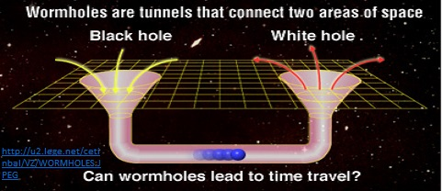
Psychological Space-Time Continuum
Cognitive
Vortex
Functional
Vortex

Slide 32
BOX 0.3: Latent learning (Tolman & Honzik, 1930)
Day 1: Maze without food
Day 2: Maze with food
    => faster food retrieval on day 2 if maze without food on day 1
For functional psychologist: Not specially
B-day2 = f (Er-day1) = functional cause
For cognitive psychologist: Crucial
There should be immediate cause on day 2
The only possibility is knowledge of the maze

Slide 33
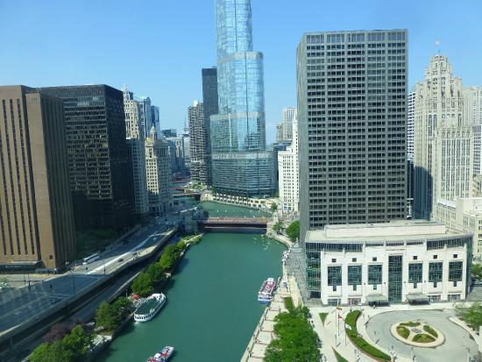


BOX 0.4 : Behaviorism and the "cognitive revolution".
33

Slide 34
0.3.3. Relation functional - cognitive psychology

Slide 36
Separate EFFECT vs. MENTAL PROCESS
e.g.. Confusing classical conditioning as an effect with mental process (e.g., forming associations)

Slide 37
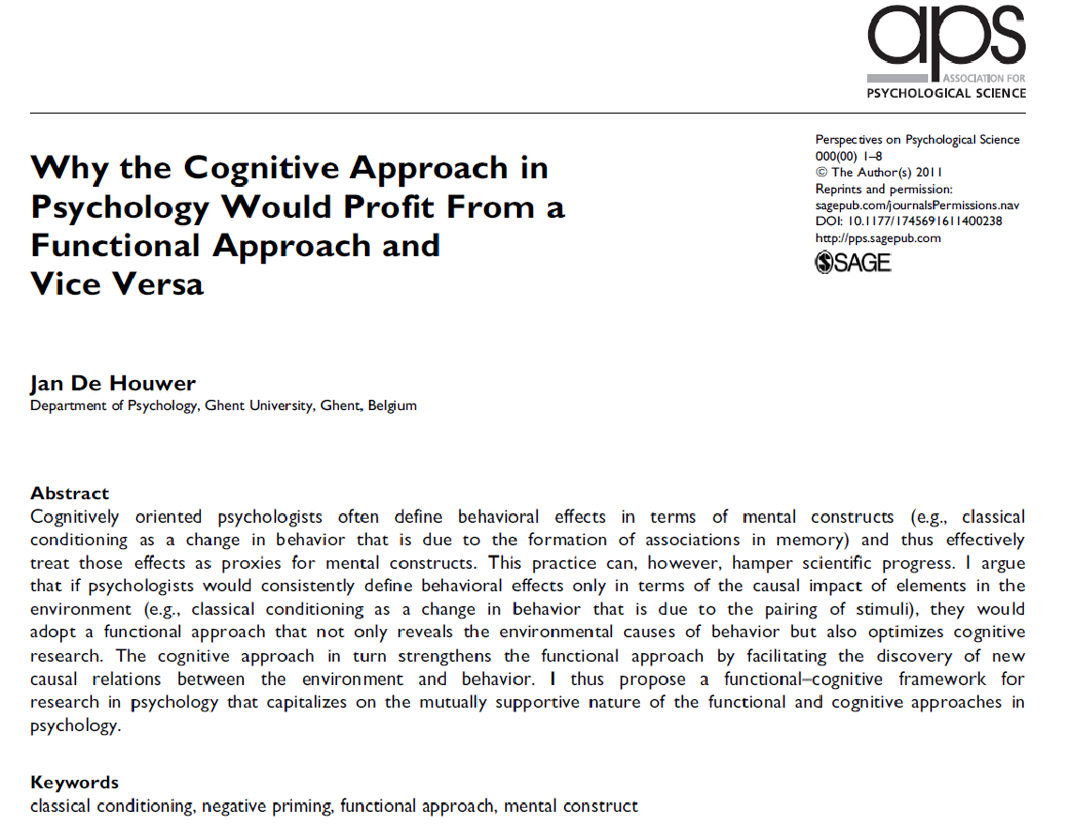

Slide 38
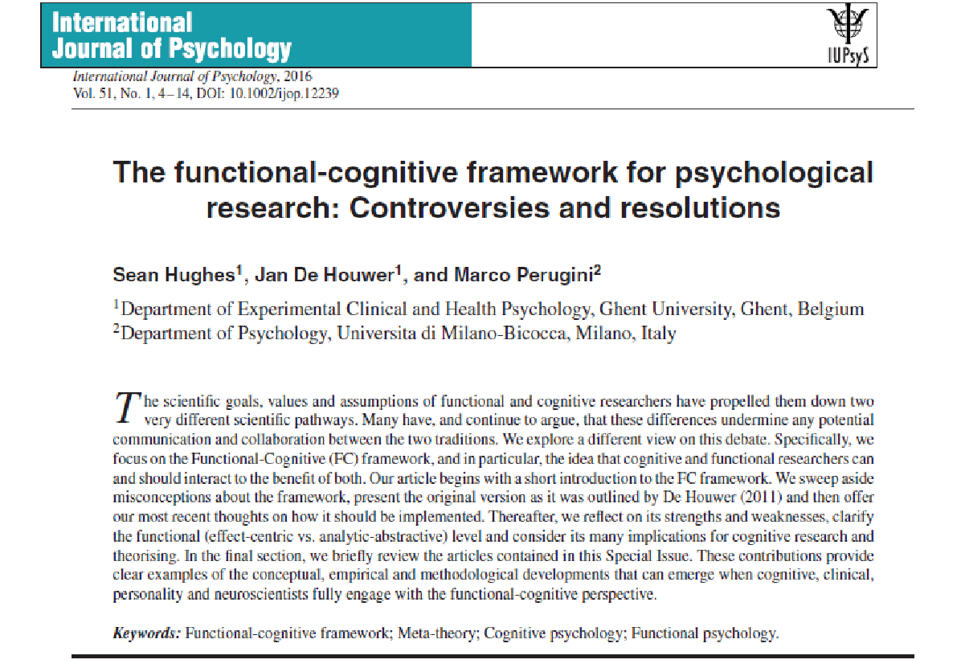

Slide 39
0.4. Structure of the course
1. Five chapters (in addition to introductory chapter):
Chapter I: Effects of non-contingent incentive provision
Chapter II: Classical Conditioning
Chapter III: Operant conditioning
Chapter IV: Complex forms of learning
Chapter V: Applied learning psychology

Slide 40
2. Structure of each chapter: both approaches
- Functional knowledge
- Mental process theories
3. What not?
- other determinants of behaviour (e.g. genes)
- neuroscience (and connectionism)
BASIC VISION: Learning psychology as a lens to understand behaviour

