Slide 1
Chapter IV
COMPLEX FORMS OF LEARNING:
JOINT EFFECTS OF MULTIPLE REGULARITIES

Slide 2
IV.0. Some basic terms
(see also introductory chapter)
Complex learning = joint effect of multiple regularities
2 types of complex learning based on type Er
- Moderated learning: effect of multiple standard regularities (= regularities with single stimuli / behaviors)
- Effects of meta-regularities: effect of Er of which at least one element is itself an Er

Slide 3
IV.1. Functional knowledge
IV.1.1. Two types of complex learning
IV.1.1.1. Moderated learning
= joint effect of several standard regularities.
(i.e., effect would not have occurred without one or more of the regularities)
=> many examples in previous chapters (e.g., sensory preconditioning, conditioned reinforcement, DOE, ...)
=> And there are many other examples
E.g. PIT: light gets function of Sd for lever press after "light - food" + "lever push - food".

Slide 4
Importance of the concept “moderated learning”
=> shows what is common (heuristic)
=> allows to related different effects
Example: role of intersecting regularities
sensory preconditioning
Faze 1: light - tone
Faze 2: tone - food
Test: light elicits CR
PIT
Light-food
Press lever -food
Light functions as Sd

Slide 5
conditioned reinforcement
Light - food
Press lever - light
=>Light functions as Sr
PIT
Light-food
Push lever -food
=> Light functions as Sd

Slide 6
Hughes et al. (2016): Intersecting regularities (IR)
= 4th type of regularity => 4th type of learning
=> new examples of learning through IR
=> more choices for brand S2 than brand S42

Slide 7




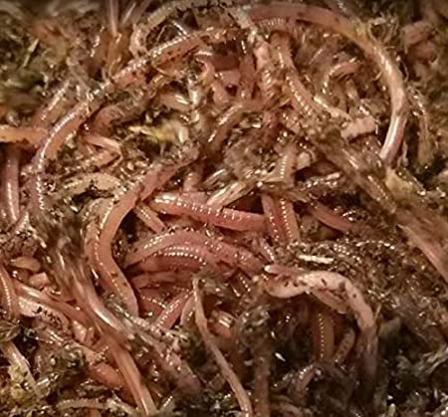



CUG
VEK

Slide 8

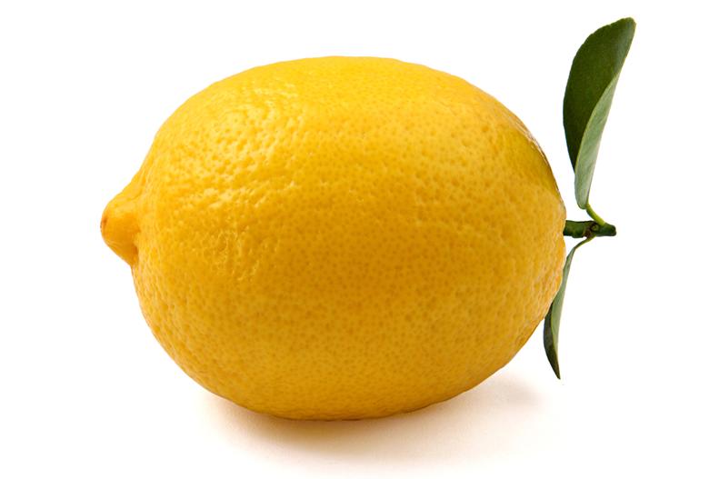
IV.1.1.2. Effects of meta-regularities
Regularities in occurrence of regularities
Enables the study of the functions of relations and regularities
The functions of relations: Relational learning
regularities allow the identification of relations (equal, different, larger, ... with regard to different features)

Slide 9
Relational behaviour: B = f (relation)
a: ---------- a: ----------
b: ----- b: --------------
a: ----- a: -----
b: --- b: -------
=> people and other animals can choose the biggest option above chance
=> relation = stimulus class with relation as unit (e.g., stimulus "a is largest" vs. stimulus "b is largest")

Slide 10
Relational learning: B = f (Er with relation as stimulus)
=> meta-regularities allow to consider relations as stimuli and thus to study relational learning;
e.g., Matching-to-sample
= effect of Sd: R - Sr meta-regularity with relation between stimuli as Sd

Slide 11
Eg. Relational matching to sample:
= effect of Sd: R - Sr meta-regularity with relationship between relations as Sd

Slide 12
And many other examples of relational learning
(e.g., effects of repeated occurrence of a relation; effects of co-occurrence of a relation and ashock or of two relations)
=> see different types of learning (intro chapter)
+ Relations can have all kinds of stimulus functions (Sd, Sr, CS, occasion setter, ...).

Slide 13
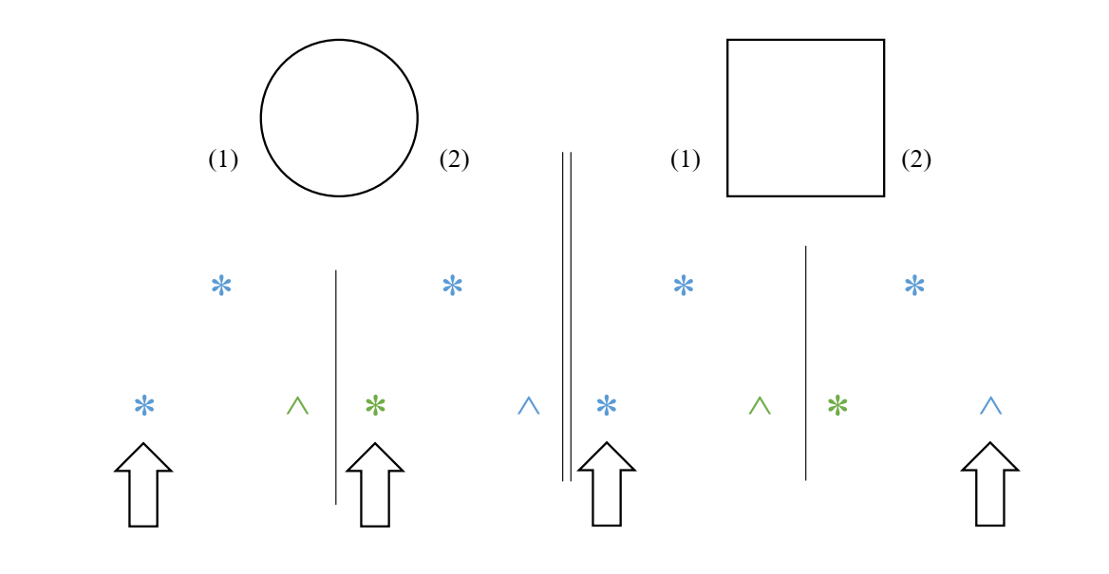
Crucial function for relational behavior: Contextual Relational Cue
+ Relations can also perform the function of Crel

Slide 14
(b) The functions of regularities: Regularities as Crel
regularity as a stimulus class:
unit = spatio-temporal characteristics
(e.g., occur together in time and space)
regularity can have all kinds of stimulus functions (e.g., Sd, Sr, CS, occasion setting, ...)
And also the function of Crel (vb. AARR) => Learning 2.0

Slide 15
- AARR: Pretending that stimuli are related

Slide 16
IV.1.2. Learning 2.0
Regularity is not a direct cause but a relational cue (Crel)
Eg. Evaluative conditioning:
Vekte (CS) - Flowers (US) => Vekte positive
Example. Learning by analogy: on every trial 2 regularities
Er1: Vekte - Flowers Er1: Vekte - Flowers
Er2: Full – Full Er 2: Empty - Full
=> Vekte positive => Vekte negative
Learning 2.0: Er1 = Crel; Er2 = higher-order Crel
=> EC = AARR

Slide 17
Is all learning AARR???? Do all regularities function as Crel?
Eg. Mere exposure: frequency of stimulus is Crel for similarity between that stimulus and positive stimuli (which are often high frequency)
=> invert ME by inverting Crel function of frequency?
e.g. learning by instructions: Using language is also AARR

Slide 18
New era in learning psychology: Learning 2.0
=> Is learning influenced by context?
=> Is learning in (linguistic) humans fundamentally different?
=> New research questions
- How is Crel function acquired?
- How can Crel function be changed?
- How do different Crels interact?

Slide 19
IV.2. Mental process theories
- So far, complex learning has not been considered as unified class of learning effects, so only research on separate phenomena
- Mostly from the perspective of associative models (e.g., chains of associations)
CS1-------CS2-------US
- But can also be based on inferential reasoning based on propositions
- Models also needed for NAARR and AARR

