Slide 1

APPLIED LEARNING PSYCHOLOGY
USING LEARNING PRINCIPLES TO IMPROVE THE WELLBEING OF INDIVIDUALS AND GROUPS

Slide 2
Probeer een voorbeeld te bedenken van hoe leerprincipes gebruikt kunnen worden om welzijn te bevorderen op het niveau van een individu of een groep.

Slide 3
Is Learning Psychology Actually Useful?

Slide 4







Notes:
Misschien denk je nog steeds dat de leerpsychologische kennis enkel van toepassing is op niet-menselijke dieren. Mensen lijken inderdaad allerlei unieke kenmerken te hebben zoals taal, creativiteit, en vrije wil, kenmerken die er voor zorgen dat hun gedrag, gedachten en gevoelens moeilijk voorspeld of beïnvloed kunnen worden. Een oppervlakkige lezing van ons boek zou dit idee misschien kunnen versterken omdat we vaak hebben verwezen naar onderzoek met schijnbaar eenvoudige organismes (vb., ratten en duiven) en procedures (vb., doolhoven en Skinner boxen).
Maar de conclusie dat de leerpsychologie alleen relevant is voor ratten en duiven zou een grove misrepresentatie zijn van de inhoud van ons boek. Vaak is het zo dat de factoren die een invloed hebben op het gedrag van eerder eenvoudige organismes zoals planten, vissen, ratten, en duiven ook een hebben invloed op het gedrag van meer complexe dieren zoals dolfijnen, octopussen, bonobo’s en, jawel, ook mensen.

Slide 5




Notes:
Om die reden kunnen de concepten die we in ons boek besproken hebben (vb., klassieke en operante conditionering) ook ingezet worden voor het bevorderen van het welzijn van mensen.
Deze concepten vormen de kern van interventies die een positieve impact hebben op het leven van miljoenen kinderen en volwassenen met ontwikkelingsstoornissen.
Leerprincipes dragen bij tot ons begrip van gedrag in een economische context
Laten ons toe om het functioneren en welzijn van werknemers in bedrijven te optimaliseren.
Ze helpen psychologen bij het vormen van het gedrag van ouders en leerkrachten.
Ze worden gebruikt om drug en alcohol misbruik in te perken in de context van verslavingen.
Vormen het kloppend hart van vele therapieën voor de behandeling van fobieën, paniek- en angststoornissen, chronische pijn, psychose, en depressie.
En veel meer…

Slide 6




OVERVIEW
1. Learning Psychology in 5 Minutes
2. Functional Analysis: A Toolbox for Changing Behavior
3. Applied Learning Psychology: Individuals
4. Applied Learning Psychology: Groups
Notes:
Leerpsychologische kennis niet enkel kan toegepast worden op het niveau van één individu maar ook op het niveau van groepen (vb., families, scholen). Misschien nog belangrijker – zeker gezien de wereldwijde uitdagingen waar we momenteel voor staan – zijn de toepassingen van leerprincipes bij het voorspellen en beïnvloeden van gedrag op het niveau van een cultuur, samenleving of systeem.
So in this lesson we will:
Quickly revise what you have learned in this course until now (i.e., Learning Psychology in 5 minutes).
Discuss how applied learning psychology can help us design interventions to help individuals.
Discuss how applied learning psychology can help us design interventions to help groups.

Slide 7
Learning Psychology (in 5 minutes)

Slide 8
Learning
Mediators
(Mental Level)
Change in Behavior
Regularities
Moderators
(Functional Level)
Notes:
In this course you learned that there are systematic patterns in the environment (either put there by us, or which are naturally occurring), and that we call these patterns regularities. These regularities can lead our behavior to change in ways that we can predict and influence. Learning Psychology involves the study of these regularities, as well as the factors that moderate and mediate the relationship between them and changes in behavior.

Slide 9

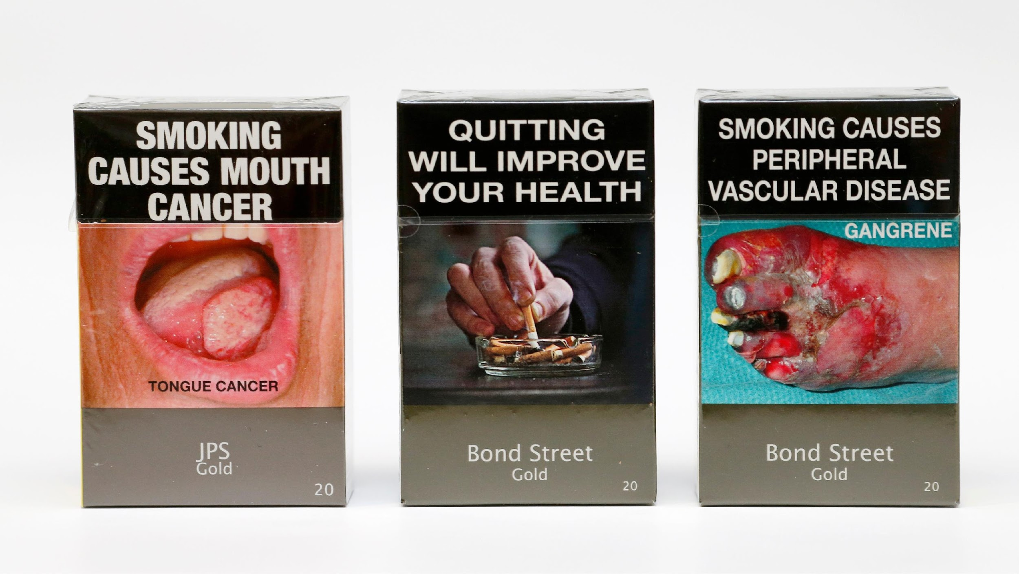
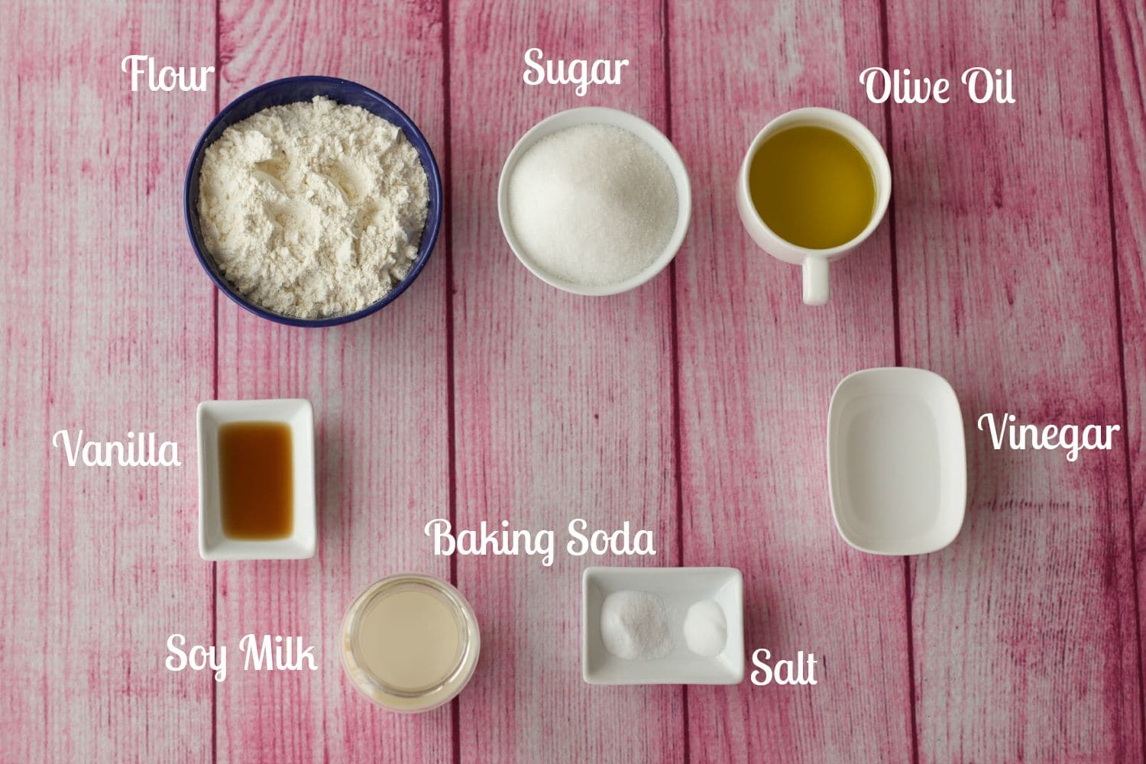



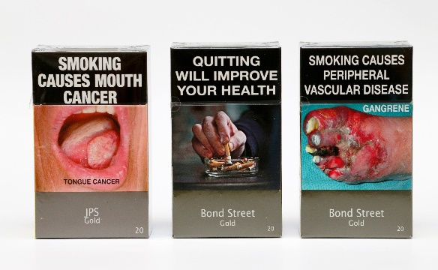



Learning
Ontogenetic Adaptation
(Change in behavior due to regularities in the environment)
Sd
R
Sr
Regularities
One stimulus
Two Stimuli
Stimuli & Responses
Interacting &
meta-regularities
Sd
R
Sr
Sensitization or
Habituation
Classical conditioning
Operant Conditioning
Relational Learning
Notes:
There are several ways of manipulating the environment to change behavior. We can introduce:
Regularities in the presence of a single stimulus
Regularities in the presence of two stimuli
Regularities in the presence of stimuli and responses
Interactions between regularities and meta-regularities
Now if our interventions are going to be successful we need to not only consider regularities but also their moderators. In other words, we have to think of our interventions as something like cake recipes…if you want to bake a cake you don’t just throw butter and sugar and flour into the oven. You find the right levels of each and add them at just the right time. The same with interventions. You have to figure out what are the important regularities, and what their moderators are.
In short, we can use regularities and the functional knowledge to influence our own behavior and that of others...

Slide 10
Part I: Applied Learning Psychology
Notes:
In de toegepaste leerpsychologie probeert men daarentegen om interventies en technologieën te ontwikkelen die specifieke vormen van gedrag in de echte wereld kunnen veranderen. Dit kan op twee manieren: via het manipuleren van regelmatigheden in de omgeving en potentiële moderatoren van leren (toegepaste functionele leerpsychologie) en via het beïnvloeden van de mentale processen die het effect van regulariteiten op gedrag mediëren (toegepaste cognitieve leerpsychologie).
We will focus on the former in this lesson as they seem to have had the greatest impact in the real-world.

Slide 11

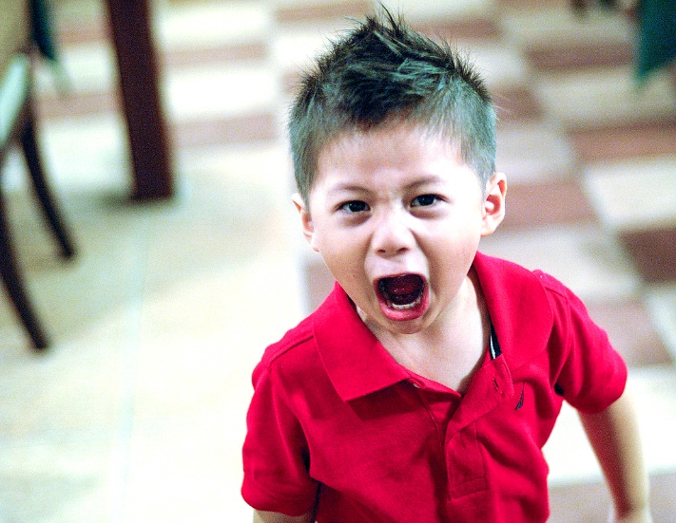
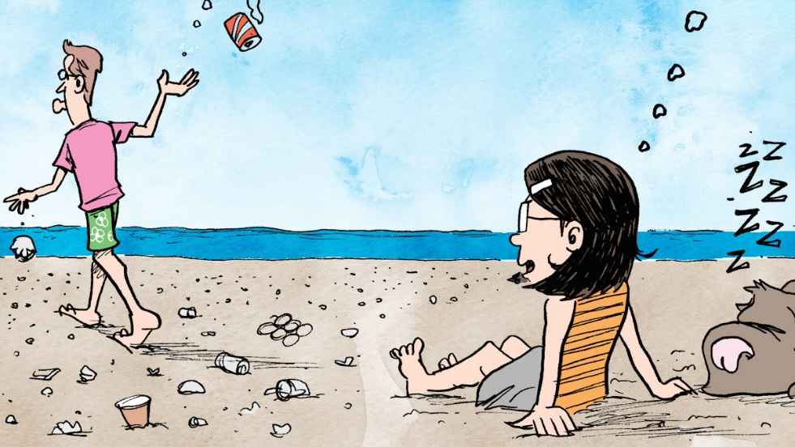
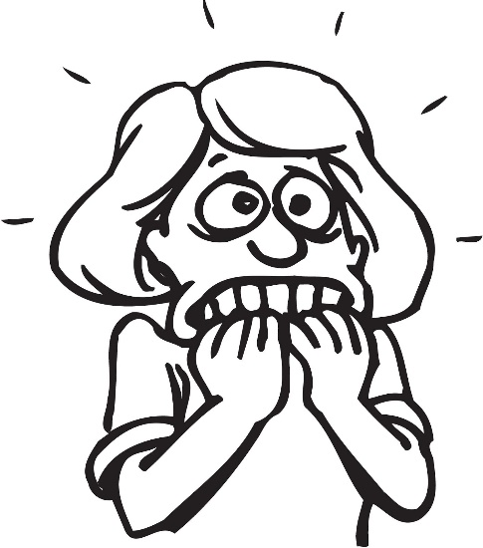
APPLIED BEHAVIOR ANALYSIS (ABA)
Behavior
Regularities
+
Functional Knowledge
Notes:
Veel toegepaste functionele leerpsychologen hebben zich gegroepeerd en een veld gevormd dat bekendstaat als toegepaste gedragsanalyse (Applied Behavior Analysis of ABA). Deze groep is geïnteresseerd in de wetenschappelijke studie van gedragsverandering op basis van leerprincipes:
Ten eerste ligt de focus op gedrag. Kwesties zoals huwelijksproblemen, agressie, overvloedige consumptie, en fobieën worden benaderd als zijnde problematisch gedrag waarvan men de frequentie wil beïnvloeden.
Ten tweede is ABA gebaseerd op de overtuiging dat leerprincipes ons kunnen helpen begrijpen van gedrag.
Ten derde zal men op basis van leerprincipes interventies ontwikkelen die gedrag beïnvloeden. Gedragsanalisten focussen hierbij op het manipuleren van de omgeving. Voorafgaand aan zo’n interventie zal de gedragsanalist eerst een functionele analyse maken van het gedrag dat hij of zij beoogt te veranderen.

Slide 12

WE CARRY OUT A FUNCTIONAL ANALYSIS
Notes:
Een functionele analyse vereist het identificeren van de gebeurtenissen die voorafgaan aan (antecedenten) en volgen op (consequenties) het doelgedrag. Het vertelt ons welke antecedenten het gedrag controleren en welke uitkomsten het bekrachtigen. Eénmaal dat de functionele analyse uitgevoerd is zal de gedragsanalist bepalen wat de gewenste uitkomst is van de interventie en hoe de interventie er zal uitzien.
Most functional analyses follow a similar strategy. To illustrate, let’s consider a phenomena known as Trichotillomania – compulsive desire to pull one’s hair out.

Slide 13
1. IDENTIFY THE BEHAVIOR(s) WE WANT TO CHANGE
(B)EHAVIORS
Tactile search for hair
Pulling hair from certain body regions
Examining hair before & after pulling.
Notes:
Addressing compulsive hair pulling (from an applied learning psychology perspective) involves six steps:
Step 1: Identify the behavior(s) we want to change. Note: in many cases it is not just one behavior that we want to change but rather a class of behaviors (i.e., a group of behaviors that are triggered and maintained by the same stimuli. So in this example, we don’t just want to change compulsive hair pulling. We also want to change the entire class of behaviors (e.g., searching for hair, pulling from certain body parts, examining the hair before and after pulling it out).

Slide 14
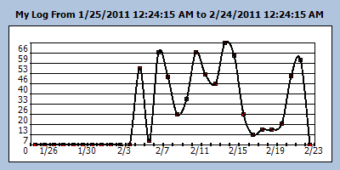
2: GATHER BASELINE DATA
Amount of Hair Pulling
Time
Notes:
Step 2: Once we have figured out what behavior(s) we want to change we need to figure out how often those behaviors occur. This way when we implement our intervention we have pre-intervention behavior and post-intervention behavior rates. We can compare these to see if the intervention was successful or not. In other words, we obtain baseline data prior to the intervention. We record behavior and can do so in different ways: (a) record every instance of the behavior [event recording], only specific periods of time [interval recording], or over a long-time scale [time sampling]).

Slide 15
3. IDENTIFY THE ABCs
(A)NTECEDENTS
(B)EHAVIORS
(C)ONSEQUENCES
Home vs. work
Unwanted thoughts
Presence ugly or unwanted bodily hair
Tactile search for hair
Pulling hair from certain body regions
Examining hair before & after pulling.
Relieve stress, boredom, anger
Distraction from unwanted thoughts
Removes criticism or disapproval
Removal of ugly or unwanted bodily hair
Notes:
Step 3: We identify the ABCs – in other words – the stimuli that come before the behavior (Antecedents), the Behaviors we are interested in, and the stimuli that come after those behaviors (Consequences). This helps us figure out what aspects of the environment might be controlling the behavior we want to change. For instance, in this example, it seems that the hair pulling behavior only happens at home and not at work, when the person is experiencing unpleasant thoughts, and can see body hair that they consider to be ugly or unwanted. After they pull the hair they are no longer bored, stressed, or angry (because they are now busy with a task or distracted by the physical sensations). They also escape from the unwanted thoughts. Others might see the consequences of hair pulling and no longer criticise or ask them to do certain things (i.e., they escape or avoid unpleasant tasks), or they remove body hairs they considered to be ugly or unwanted.

Slide 16
4. What is The Function (WTF)?
(A)NTECEDENTS
(B)EHAVIORS
(C)ONSEQUENCES
Home vs. work
Unwanted thoughts
Presence ugly or unwanted bodily hair
Tactile search for hair
Pulling hair from certain body regions
Examining hair before & after pulling.
Relieve stress, boredom, anger
Distraction from unwanted thoughts
Removes criticism or disapproval
Removal of ugly or unwanted bodily hair
R
Sr
Sd
Notes:
Step 4: it is not enough to know what stimuli come before and after behavior. We also need to know if these events are functioning to trigger the behavior (i.e., are functioning as antecedents), and are maintaining the behavior (functioning as consequences) (see the section of your Learning Psychology handbook on the difference between the descriptive and the functional levels). It might be that unwanted thoughts and being at home BOTH come before hair pulling but that ONLY being at home is functioning as an Sd (i.e., as a signal that hair pulling will lead to certain consequences). The same goes for the stimuli that come after the hair pulling – it might be that hair pulling removes hair from the body but that it is the escape and avoidance of stress that serves to maintain the behavior.
In other words, we always need to figure out WTF: what is the function of the stimuli that control behavior, and do they really have this function or are they merely descriptively part of our analysis.

Slide 17
5. WE CHANGE THE CONTINGENCIES
(A)NTECEDENTS
(B)EHAVIORS
(C)ONSEQUENCES
Context: Manipulate hair pulling environment (e.g., cover mirrors, remove tweezers, use sticky notes).
Motor: Physical barriers to reduce hair pulling (e.g., glasses, hats, gloves). Sds (e.g., loud bracelets, elbow braces, and perfume) can increase awareness of hair pulling.
Sensory: DRO: if sensory activation → use brushes, pens, massages to ease sensations in scalp.
Motor: DRI: If boredom → physical activity (e.g., clay or knitting)
Cognitive: If thoughts → hair pulling (e.g., “My hair has to look perfect”) then reinforce acceptance & alternative thinking (e.g. “It’s okay to be imperfect”).
Social: Recruitment of social environment (e.g., partner, parent) into the contingencies and delivery of consequences
Affective: If certain emotions occasion hair pulling → emotional regulation/ meditation. If boredom → stimulating activities (draw, music, read, paint, photography).
Notes:
Step 5: Now that we have identified what we think are the ABCs and the WTF (i.e., the stimuli that trigger and maintain the behavior and how they are doing so) it is time to test if this is actually the case. We might be wrong. So we need to intervene on the contingencies to see if we have identified the correct stimuli and if this leads to a change in behavior.
For instance, in the current example, if context (being at home) is an Sd signaling that hair pulling will lead to certain consequences then we can manipulate the home environment so that it does not trigger the response (e.g., we might cover the mirrors around the house, get rid of any instruments the person used to pull the hairs, keep doors open to reduce privacy). If the Sd is cognitive in nature (e.g., an unwanted though triggers the hair pulling behavior) we might intervene by reinforcing acceptance and alternative coping strategies. If the Sd is affective in nature (e.g., certain emotions occasion hair pulling then we might introduce emotional regulation/mediation strategies. If it is boredom then we remove this stimulus (e.g., by introducing more stimulating activities).
Likewise, we need to tackle the consequences and break the R-Sr relationship. We can do this in different ways. For instance, if the consequences maintaining hair pulling are sensory (e.g., it feels pleasant to pull the hair) then we differentially reinforce other behavior (DRO) that produces similar consequences (e.g., produce the same sensory outcomes via hair brushes, pens, massages). If the consequences are motor in nature (e.g. escape or avoidance of boredom then we differentially reinforce incompatible behavior that alleviates boredom and is incompatible with hair pulling; e.g., clay or knitting). The same goes for social consequences.
The point here is that we engage in contingency management - we systematically test if the functional analysis we carried out was correct by altering the stimuli that control behavior. If we are successful then we should observe a change in the behavior under investigation. If our functional analysis was incorrect (which is possible) then we need to go back to the earlier steps and identify the ABCs and WTF that we missed before.

Slide 18
HOW DO WE KNOW IF IT WORKED?
Notes:
So at this point we have 1. identified the behavior we want to change. 2. gathered baseline data so we can get a sense of the extent of the problem and compare it to the behavior we see after our intervention. 3. we identified the Antecedents, Behaviors, and Consequences (ABCs). 4. we considered what the function (WTF) might be of these stimuli and responses, and then 5. designed and implemented a contingency management intervention designed to get rid of the problematic contingencies and replace them with the desired contingencies and outcomes.
Now at this point we need to ask: did all of this work? In other words, did our intervention produce the desire change in behavior? To answer this we need to engage in an efficacy test (i.e., test if our intervention was effective).

Slide 19



A-B-A-B DESIGN
A-PHASE
10 TIMES
PER WEEK
B-PHASE
Reduction in Boredom
1 TIME
PER WEEK
Notes:
Two common ways we can do this in applied learning psychology are known as (A-B-A-B designs) and (multiple baseline designs).
In A-B-A-B designs we alternate between an A phase in which there is no intervention (baseline), and the B phase where there is an intervention. For instance, imagine that a client comes to you displaying the characteristic behaviors associated with Trichotillomania. During the A-phase, you would repeatedly measure their behavior to determine how often the behavior occurs. In the B-phase you manipulate the contingencies that sustain this behavior. If there is a change in the client’s behavior (e.g., she no longer pulls her hair out at a high rate), and our intervention was responsible, then bringing back the A-phase should cause behavior to return to what it was before (i.e., the client should return to pulling their hair out at a high rate). Bringing the B-phase back should cause the behavior to change once more.
Note: we often cannot do this in clinical settings because it would be unethical to re-expose the person to harm or problematic behaviors like this. Therefore A-B-A-B designs are useful but not in all situations. Therefore we need another way of measuring if our intervention was effective.

Slide 20
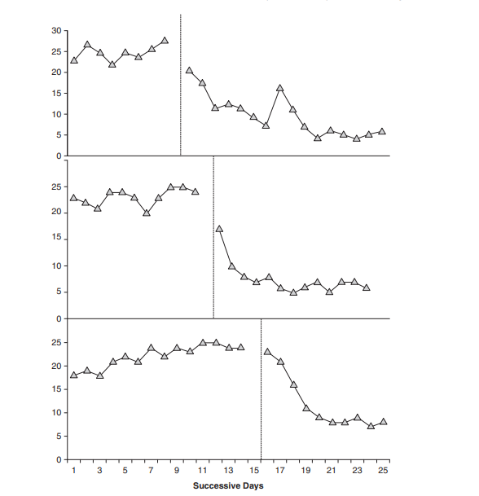


MULTIPLE BASELINES: ACROSS BEHAVIORS
Baseline
Treatment
Notes:
Multiple baseline designs involve the intervention and baseline being applied at the same time.
There are different types of multiple base line designs. We can apply multiple baselines across behaviors. For instance, we could first apply our intervention to one behavior (pulling hair from the head) and then to a second behavior (pulling hair from eyebrows) and then to a third behavior (pulling hair from the armpits). In this way we see a decrease from pre to post intervention rates of behavior in each case. However, the baseline behavior is still high when the intervention is not being applied (see the second and third sections of the above graph).

Slide 21
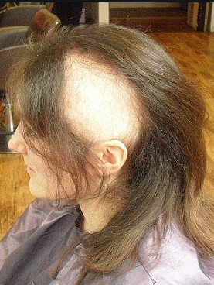


MULTIPLE BASELINES: ACROSS SUBJECTS
Rachel
Joey
Monica
Notes:
We could also test using a Multiple baselines across subjects. For instance, we could apply the intervention to one person (Rachel) and then at a later point to a second person (Joey) and then at a later point in time to a third person (Monica). In this way we see that the baseline rates of behavior reduce within subjects. But the baseline levels of behavior between subjects is still high until the intervention is applied in their particular case.
Note: that this type of design is useful in non-clinical contexts where the behavior undesireable but not dangerous (e.g., in school or work settings).

Slide 22
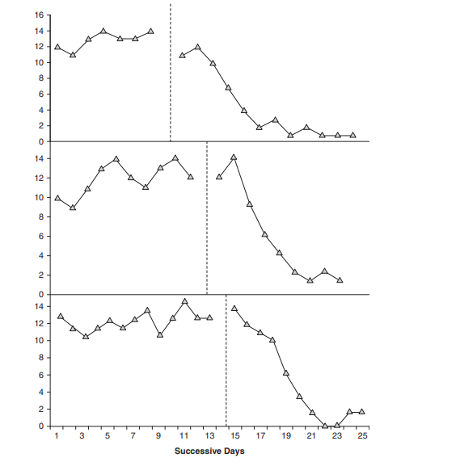
MULTIPLE BASELINES: ACROSS SETTINGS
MULTIPLE BASELINES: ACROSS SETTINGS
Baseline
Treatment
Bathroom
Bedroom
Living room
Notes:
Finally, we could test if our intervention was effective using a Multiple baseline across settings design. For instance, we could first apply our intervention in one context (e.g., the bathroom) and then in a second context (e.g., the bedroom) and then in a third (e.g., living room). In this way we see a reduction from baseline to post intervention behavior within each setting. But the baseline level of behavior is still high between settings, until the intervention is applied (see the second and third parts of the graph).

Slide 23
HOW DO WE MAKE THE CHANGE STICK?
Notes:
Imagine that we test and see that our intervention works. We want to make sure that the change in behavior we established is maintained across time and context (i.e., that the outcome sticks). Take the previous example of hair pulling. Imagine that after treatment the client no longer pulls her hair at home but still does so in the bathroom of work or at her sister’s house. If so then the new behavior has not generalized.

Slide 24
6. TRAIN FOR GENERALIZATION
Stimulus Generalization
  Different stimuli and contexts occasion behavior
Response Generalization
  Behavior spreads to other related responses
Behavioral Maintenance
  Change persists when contingencies are removed
Notes:
Behavioral interventions are highly effective if they decreases problem behaviors across many different settings with different individuals. We can help this occur by training for generalization. Generalization can happen across 1) settings, 2) time and 3) across people. It occurs when the behavior occurs in these various dimensions without the need for additional intervention.
Stimulus generalization (different stimuli and contexts occasion the new behavior we established in the intervention)
Response generalization (different members of the behavioral class are also controlled by the stimuli that make up ou intervention)
Behavioral maintenance (the change in behavior we established in the intervention persists even after we remove the contingencies that made up the intervention)

Slide 25




Behavioral Problem
Regularities & Principles
Functional Analysis
Behavior Change
Notes:
Imagine that you have a problem at home (e.g., your sink is blocked). What would you do? You’d probably get out your box of tools (or have your landlord or parent do so), identify the issue, and use the tools to solve the problem (e.g., remove the block in the sink so that the water flows again).
Applied learning psychology is somewhat similar. We identify our problem (the behavior we want to change), we take out our toolbox (regularities + functional knowledge), and apply it to the problem (conduct a functional analysis and test if it worked) in order to produce some outcome (the desired behavioral change).
The concepts and ideas covered in this course represent your toolbox and will form the basis of your intervention.

Slide 26
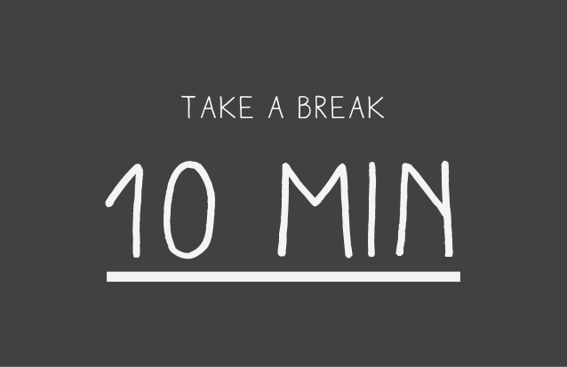

Slide 27
Q1. Which of the following is NOT part of a functional analysis?
a. Gathering baseline data on behavior
b. Identifying what is functioning as an Sd
c. Changing the mental associations between R-Sr
d. Testing if the intervention works
Notes:
As we learned in the previous sections, gathering baseline data on behavior is crucial to better understand when and how much a certain behavior is occurring, and to allow us to compare that rate with the rate we observe after the intervention. So option a. is part of a functional analysis. We also need to understand what stimuli trigger and maintain behavior (ABCs) and WTF (what is the function) is of these stimuli. Therefore we definitely need to figure out what is functioning as an Sd. So option b. is part of a functional analysis. The intervention we develop is located at the functional level of analysis (i.e., centers on the relationship between environment and behavior) and says nothing about the mental level (e.g., associations). Therefore option. C is NOT a part of a functional analysis. Finally, we need to test if our intervention works – otherwise we do not know if we were successful. There are several ways we can do so (all of which rely on ‘single subject’ designs; e.g., A-B-A-B designs or multiple baseline designs). So option d. is part of a functional analysis.

Slide 28
Q2. Your client is addicted to facebook and their email. They check both 50 times per hour. You conducted a functional analysis and implemented an intervention. The client now only checks facebook 2 times per hour.
If you were to train for response generalization what would you want to see happen?
a. The client’s checking behavior would disappear completely
b. The client’s email checking would also decrease in frequency
c. The client would start using Instagram
d. The client would check Facebook more than before
Notes:
Response generalization aims for other members of the class of behaviors to be controlled by the stimuli in the same way as the behavior we established is. So if Facebook and email checking behaviors are part of the same class of behaviors, then response generalization would involve email checking also being influenced in a similar way as Facebook checking (i.e., being reduced). This option b is the correct response. It is unlikely that the checking behavior disappears completely, nor would be want the client to stop checking their email or Facebook altogether (i.e., it is useful to sometimes check one’s email). Just not 50 times per hour. So option a is incorrect. Our intervention is not designed to increase social media use so options c and d are also incorrect.

Slide 29
Six Steps in a Functional Analysis
1. Identify the behavior we want to change
2. Gather baseline data
3. Identify the ABCs
4. What is the function? (WTF)
5. Change the contingencies & assess for impact
6. Train for generalisation
Notes:
So we have briefly examined the six steps in a functional analysis. Let’s apply this to a real-world behavior in order to practice these steps some more.

Slide 30

Notes:
It is worth noting that all the examples we discuss here are over simplified for the sake of teaching purposes. In reality there will rarely be a single clear cut analysis, answer or approach.
Imagine that your friend (Mark) works in a kindergarten along with two other people. The three of them are responsible for looking after 30 children. They don’t have much time for any individual child and are constantly busy during the day. One day Mark notices that one of the children (Maggie) starts crying and now cries most days. He would prefer that the child stop crying and spend her time socializing with the other children. This would allow him to spend more time on his other duties and less time having to comfort the child and stop her from crying. The child could also use the time to learn to play with other children and socialize.

Slide 31

1. Identify the behavior we want to change
Notes:
So what is step 1? We identify the behavior we want to change. In this case it is the high rate of Maggie crying each day. It is not that we don’t want Maggie to cry at all, just to reduce the high rate (and intensity) of that behavior.

Slide 32
2. Gather baseline data
Amount of Crying
Time
Notes:
Step 2 requires that we gather some baseline data on Maggie’s behavior. We see that there are many days where she did not cry. Then suddenly she starts to cry at high levels. But not all the time. Some days are better than others. This suggests that there is something in her environment that is triggering and maintaining the crying behavior. But for now we have a sense of her baseline crying rate.

Slide 33



3 & 4. Identify the ABCs and WTF
(A)NTECEDENTS
(B)EHAVIORS
(C)ONSEQUENCES
Notes:
Steps 3&4: we need to figure out what stimuli come before and after the crying behavior we are interested in. We observe the child in their environment and from talking to her parents we notice that the crying behavior only occurs in the kindergarten. It also only occurs when a certain staff member (Homer) is present, and when the child has no stimulation (i.e., is not engaged in play). We also notice that when she cries Homer runs over and soothes her, and engages in play behaviors with her. We notice that crying is less likely if Homer is not working on a given day or she is busy playing.
So it seems that the kindergarten, Homer, and boredom all function as Sds whereas social attention, and escape from boredom might be functioning as Srs.

Slide 34
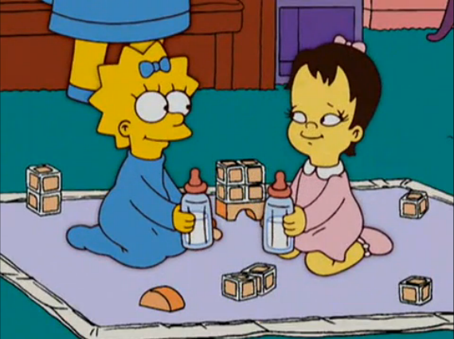
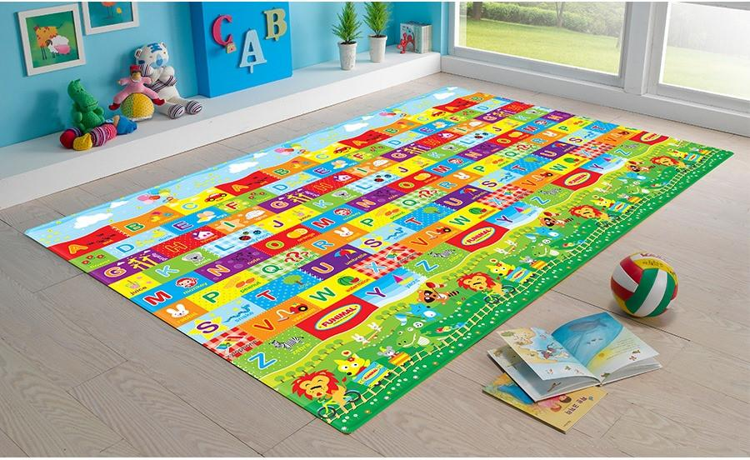
5. Change the contingencies and assess for impact
Sd
R
Sr
R
Sr
Stimulus Control
Extinction
DRO
Notes:
Step 5: we devise a contingency management intervention. For instance, if social attention and escape from boredom are functioning as Sr then we need to put this R-Sr (crying → social attention) relationship into extinction. While doing so we can differentially reinforce access to the same reinforcer via other behaviors (DRO) – for instance, we ignore the crying behavior and praise and attend to the child when she plays cooperatively with other children. We might also bring this relationship under the control of a particular setting (e.g., a certain part of the kindergarten). In other words, bring good behavior and access to reinforcers under stimulus control.
Note: naturally our intervention will be more complex – but for the sake of simplicity – let’s pretend that we could stop here.

Slide 35
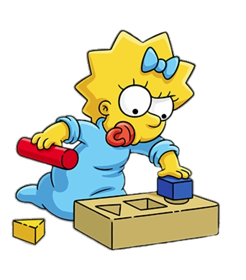
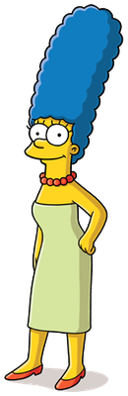
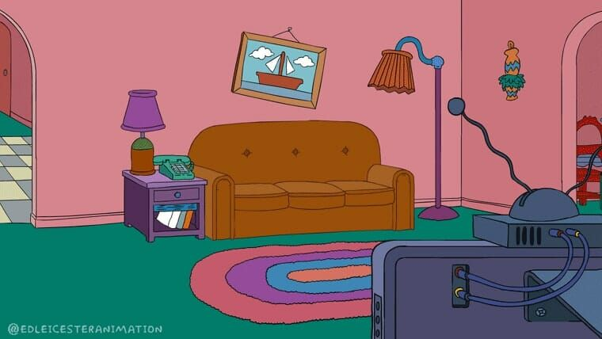
6. Train for generalization
Sd
R
Sr
Notes:
As a result of our intervention we notice that Maggie’s rate of crying behavior has reduced considerably. But we want to ensure that the behavior that we have shaped up generalizes across time (i.e., is evident today, next week, next month), across context (e.g., at home, the kindergarten, at the shop), and across individuals (e.g., not just with Homer but also with her mother Marge). This is why we would train for stimulus and response generalization and check for behavioral maintainace.

Slide 36
Part II: Applied Learning Psychology
at the Individual Level
Notes:
In Part I we learned that applied functional psychologists develop interventions that manipulate environment-behavior relationships to change behavior.
Now let’s see how these interventions are used to improve wellbeing at the individual level.
Let’s focus on three examples: issues to do with intellectual disabilities, clinical problems, and substance abuse.

Slide 37
https://www.youtube.com/watch?v=JSZKbu1-ags
Notes:
Let’s first take a look at developmental and intellectual disabilities…

Slide 38
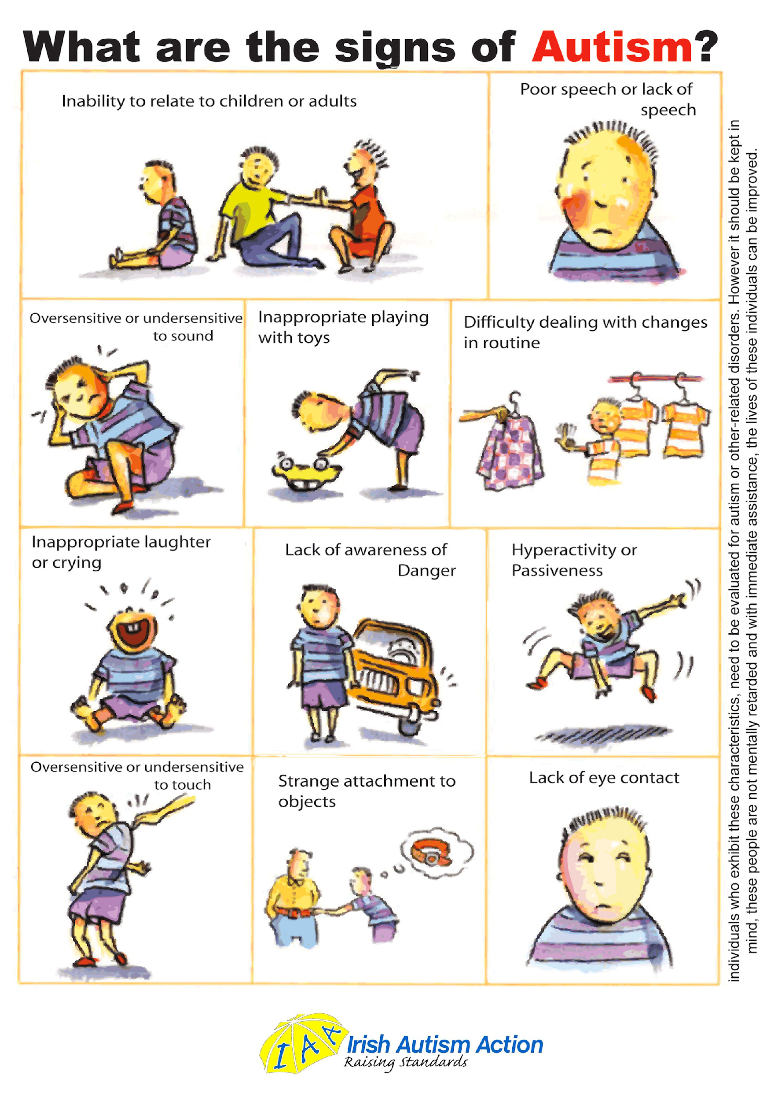
Notes:
The learning principles we discovered in the laboratory have been used to produce interventions that improve the lives of those living with developmental or intellectual disabilities.
Before operant techniques were used to help children and adults acquire skills like self-care, social, and communication repertoires, many lived short and unfulfilled lives, isolated and secluded in institutions.
Take autism spectrum disorders (ASD). Individuals with ASD often show: (a) impaired communication (repetitive speech patterns, delayed development), (b) deficits in social interactions (poor eye contact, or emotional reciprocity), and (c) abnormal behavioral patterns (repetitive or stereotypical interests and activities). People with ASD often suffer from other issues, such as sleeping and feeding disorders, delays in toilet training, self-injury, aggressive behavior, genetic and medical conditions, as well as cognitive impairments. Many of these behavioral problems and deficits can be addressed with EIBI.

Slide 39
EARLY INTENSIVE BEHAVIORAL INTERVENTIONS
Package of procedures that are:
  Applied from an early age (3-4 years)
  Intensive (20-40 hours per week)
  Individualized and comprehensive
  Train parents to function as co-therapists
Designed to improve:
  Social behavior
  Speaking and communication
  Reduce challenging behaviors
Notes:
Early and intensive behavioral intervention (EIBIs) are one of the more scientifically established approaches available for treating the behavioral deficits and issues associated with ASD. EIBIs typically consist of a ‘package’ of procedures that are systematically applied from an early age (from 3-4 years), are intensive (20-40 hours per week), individualized, comprehensive, and train parents and caregivers to serve as co-therapists.
EIBIs are typically implemented across several years and try to improve the child’s overall functioning (e.g., increase social behavior, develop speaking and communication skills, eliminate self-stimulation and aggressive behavior). When training a new skill (e.g., playing with others), the skill is broken down into smaller behaviors. They provide the child with numerous learning opportunities that shape the desired behavior in a progressive, developmental sequence, starting with basic behaviors and then moving on to more complex skills and repertoires.

Slide 40
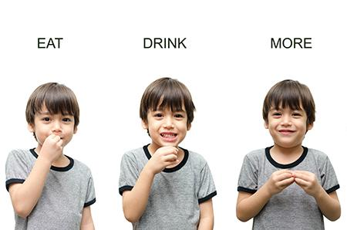

NATURAL ENVIRONMENT TRAINING
Sd
Prompt
R
Sr
Hunger
Make sign for ‘eat’
Notes:
All parts of a child’s day need to be included in the program (e.g., mealtimes, getting dressed, and social interactions). Let’s consider just one small part of EIBI called natural environment training. This procedure uses naturally occurring establishing operations (e.g., hunger) to teach language skills (making the sign for ‘Eat’ to gain access to reinforcers such as cookies). We might need to initially use prompts, and build generalization into the training (e.g., use of different stimuli, settings, and therapists) so that the verbal responses being trained are more likely to occur in different settings.

Slide 41
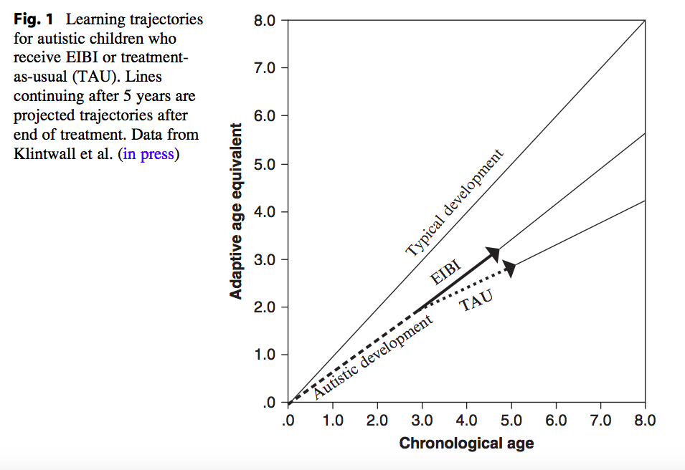
Notes:
Although seemingly time-consuming and resource-intensive, EIBIs are far more cost- effective than providing a lifetime of supervision or institutionalization. More importantly, they seem to work: these interventions equip children and adults with daily living skills, improving intellectual functioning, language development and communication skills, and are allowing many to live in ways that would have been previously unimaginable.

Slide 42


Slide 43
https://www.youtube.com/watch?v=0IbgxtdmSXE
Notes:
Let’s consider what a functional analysis might look like in this domain. First, watch a video of a parent and child interaction. The child is autistic and is demonstrating problematic (self-injury) behavior. This behavior occurs after he comes home from a walk with his mother and when he wants to immediately go back out again. To give you a sense of the problem watch the following clip.

Slide 44
Problem: young boy with autism cries & self-injures (biting, hitting). Only occurs when his mother is present and when he gets home from a walk (he wants to immediately go for another walk). When on the walk he enjoys the exercise, & counts the cars on the road. Mother tries to comfort him. But this causes him to self-injure even more. So she takes him for a second walk. The self-injury stops.
Task: Let’s attempt a descriptive (functional) analysis of this situation.

Slide 45
Problem: young boy with autism cries & self-injures (biting, hitting). Only occurs when his mother is present and when he gets home from a walk (he wants to immediately go for another walk). When on the walk he enjoys the exercise, counts cars on the road, and avoids homework. Mother tries to comfort him. But this causes him to self-injure even more. So she takes him for a second walk. The self-injury stops.
Q1: What is the MAIN behavior we want to change?
a. Taking the boy for a walk
b. Self-injury behaviors
c. Mother comforting her son when he hurts himself
        d. The boy crying
Notes:
In this situation there are multiple behaviors we want to change. The most pressing is the self-injurious behavior. The child is physically harming himself and this is the main behavior we want to address. That said, there are other behaviors we will want to address here as well: the mother’s comforting behavior seems (in this example) to be reinforcing the self-injury behavior – so that needs attention. The same goes for the boys crying – but it is lower down our list. Taking the boy for a walk is not a problem per se, unless it is talking him for a second walk when he engages in problem behavior.
So hopefully you can see that we want to address both the behavior of the parent (which is sustaining the boys behavior) as well as the boy’s behavior itself.

Slide 46
Problem: young boy with autism cries & self-injures (biting, hitting). Only occurs when his mother is present and when he gets home from a walk (he wants to immediately go for another walk). When on the walk he enjoys the exercise, counts cars on the road, and avoids homework. Mother tries to comfort him. But this causes him to self-injure even more. So she takes him for a second walk. The self-injury stops.
Question 2: What is functioning as an Sd for self-injury here?
      a. Mother
      b. Father
        c. Going for the first walk
        d. Crying
Notes:
In this example, the crying is a behavior that we want to target and not a stimulus for another behavior. So option d is incorrect. Going for the first walk certainly comes before the behavior but it is not signaling that a response (self-injury) will be consequated with attention or another walk (e.g., crying on the first walk does not signal that crying will increase a second walk). So option c is not correct. If you read the text above, the problem behavior only occurs when the mother is present – not the father so. So the father is not a signal that problem behavior will lead to the Sr. So option a is the correct answer. The mother’s presence is a stimulus which signals that a response (problem) will lead to a consequence (attention and a second walk).

Slide 47
Problem: young boy with autism cries & self-injures (biting, hitting). Only occurs when his mother is present and when he gets home from a walk (he wants to immediately go for another walk). When on the walk he enjoys the exercise, counts cars on the road, and avoids homework. Mother tries to comfort him. But this causes him to self-injure even more. So she takes him for a second walk. The self-injury stops.
Question 3: What seems to be reinforcing self-injury in this context?
a. Presence of the Mother
b. Attempts to comfort him
c. Counting cars when on a walk
        d. Exercise that comes with walking
Notes:
Although there seems to be a single clear cut answer in this case (and I’ve set it up this way for simplicity purposes) in reality there are likely many consequences. Exercise that comes from walking or counting cars on a walk do not seem to function as stimuli which increases the probably of problem behavior (in the above example). But a further analysis might indicate that they are (e.g., if manipulating these variables influences the rate of problem behavior then we can be more sure). The mother’s presence is an Sd for self-injury. If she was present but does not interact with him then it is likely that the behavior might go into extinction. Thus option a is incorrect. We see from the above example that self-injury increases as a function of the attempts to comfort him (and likely the opportunity to go for a second walk which follow). So option b is most fitting.

Slide 48
Problem: young boy with autism cries & self-injures (biting, hitting). Only occurs when his mother is present and when he gets home from a walk (he wants to immediately go for another walk). When on the walk he enjoys the exercise, counts cars on the road, and avoids homework. Mother tries to comfort him. But this causes him to self-injure even more. So she takes him for a second walk. The self-injury stops.
Question 4: What is an appropriate intervention in this context?
a. Ignoring self-injury (i.e., putting it into extinction) is enough
b. DRO (e.g., providing access to a counting game at home)
c. Going on a second walk
        d. Having the father shout at the child until he stops crying
Notes:
When answering this question try to move yourself away from the idea that the main aim is to simply decrease self-harm and towards the idea that our goal is to replace the problem behavior with another more adaptive one.
We cannot simply ignore the self-injury (even though this puts it into extinction) because doing so would increase injury to the child and this is ethically improper. So option a is incorrect. Going on a second walk will terminate the self-injury in the short term but it will increase its probability in the long term. So option c is incorrect. We could have the father shout at the child until he stops crying (i.e., punish the crying and self-injury behaviors). But this is undesirable because it only leads to a short term decrease in behavior (recall that behavior normally returns when the punishment procedure is terminated) and it is aversive to both parent and child. We could attempt to put the problem into extinction via a differential reinforcement of other behavior (DRO) procedure. For instance, it seems that counting cars and exercise are two components of the walk that are appetitive to the child. If we can provide access to these contingent on good behavior then we can (a) reduce problem behavior, and (b) increase the probability of good behavior in its place. Thus option b. is the most appropriate of the options provided here.

Slide 49
Problem: young boy with autism cries & self-injures (biting, hitting). Only occurs when his mother is present and when he gets home from a walk (he wants to immediately go for another walk). When on the walk he enjoys the exercise, counts cars on the road, and avoids homework. Mother tries to comfort him. But this causes him to self-injure even more. So she takes him for a second walk. The self-injury stops.
Question 5: How could we best test if the intervention was successful?
a. Use an A-B-A-B design
b. Use a multiple baselines – across subjects design
c. Use a multiple baselines – across situations design
        d. Use a multiple baselines – across behaviors design
Notes:
If we use an A-B-A-B design then we would measure the self-injury behavior (A), intervene (B), take our intervention away (A), and bring it back again (B). We could do this but it would involve increasing the child’s contact with self-injury behaviors during the A phases and this is not ethical. So option a. is incorrect. We could use a multiple baselines approach – but comparing the intervention across subjects (e.g., different children) won’t tell us if it is effective in the child we are interested in – just that the intervention is effective. So option b. is not so useful here. We could use options c and d. Measure if the intervention serves to decrease problem behaviors across different situations and behaviors.

Slide 50
Problem: young boy with autism cries & self-injures (biting, hitting). Only occurs when his mother is present and when he gets home from a walk (he wants to immediately go for another walk). When on the walk he enjoys the exercise, counts cars on the road, and avoids homework. Mother tries to comfort him. But this causes him to self-injure even more. So she takes him for a second walk. The self-injury stops.
Question 6: What is a major limitation of what we have just done?
a. Might be misleading (we don’t know if we are actually right)
b. Might not be a very reliable measures of behavior and environment
c. It is difficult and time consuming to perform
        d. We still don’t understand the mechanisms of why it works
Notes:
The main issue with our descriptive functional analysis is that it is merely a description of what we think is happening here. We cannot be sure until we intervene and test it for ourselves. This we might think we have identified the correct Sds – R – Sr and the relationship between them, but we cannot be sure until we check. This option a is the correct answer. The analyses we just preformed did not take much time or effort so option c is incorrect, the mental mechanisms are irrelevant for behavior change from an applied functional perspective so option d is incorrect. And the approach we consider here can be reliable in determining what behavior and environments are involved. So option b is incorrect.

Slide 51

Notes:
Mental health problems and substance abuse represent an enormous economic burden on society. Learning psychology has played a role here as well. It has guided our understanding of how, when, and why many clinically problems develop, and helped us craft effective treatments to alleviate those problems.

Slide 52
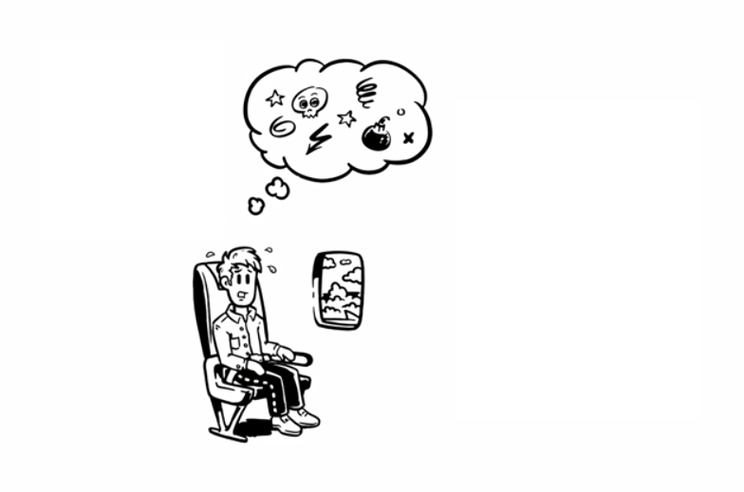

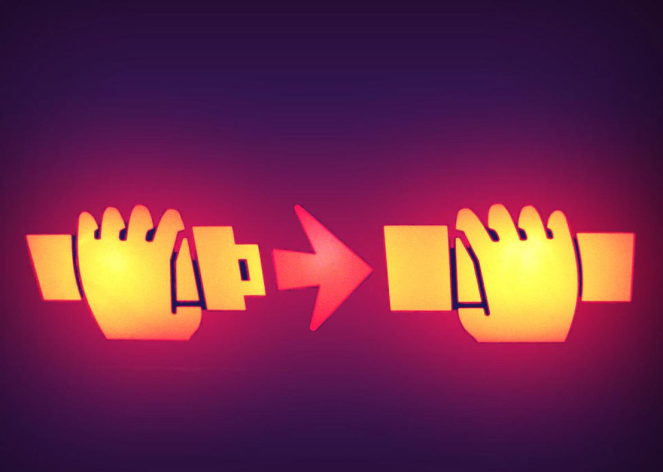


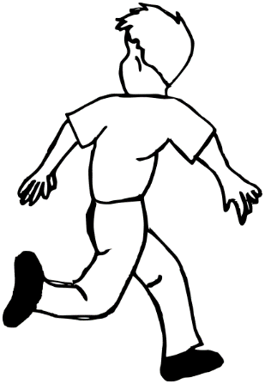

STEP 1: FUNCTIONAL ANALYSIS
Conditioned Fear Response
(A)NTECEDENTS
CS
US
Airport vs. home
Thoughts about malfunctions
Stress, Turbulence, Observations of Others
Regularities
Problematic Behavior
(B)EHAVIORS
Sweating, heart-rate increases
‘Fight or Flight’ responses
Unwanted thoughts
Avoidance Response
Sd
R
Sr
(C)ONSEQUENCES
Avoid Flying
Unpleasant to fly with…
Notes:
Traditional Behavioral Therapy. Behavioral principles were central to the emergence of behavioral therapy early in the 20th century. The core aim of BT is to (a) change those environmental factors that influence maladaptive behaviors by (b) using behavioral principles to explain and treat the problems. Therapy typically involves similar steps to what we discussed earlier: engage in a functional analysis of the problem behavior - often through single-case designs – and then operate on the contingencies maintaining that behavior.
For instance, imagine that a person enters the clinic with a fear of flying and says that this phobia first emerged when they experienced extreme turbulence on a prior flight. The clinician would first engage in a functional analysis (i.e., what are the antecedent, behaviors, and consequences, as well as properties of the person and context that need to changed in order to decrease the problem (target) behavior and increase alternative behaviors)?
They might find out that the fear of flying is a conditioned fear response stemming from past experiences (e.g., turbulence during a flight) in which flying was paired with an aversive experience. Avoiding flying is likely reinforced because it serves to decrease contact with that fear response. Based on this functional analysis the clinician would create an individualized treatment plan that tries to put the fear and avoidance into extinction by altering the relevant contingencies. They assess the effectiveness of this intervention by comparing pre-treatment to post-treatment rates of fear and avoidance.

Slide 53
https://www.youtube.com/watch?v=cR0pRYRi7_M
Notes:
BT gave rise to many procedures for treating clinical problems. One well-known technique is exposure.
Exposure techniques have the individual gradually exposed to the feared event with the aim of decreasing fear responding across successive and incrementally increased exposure.

Slide 54

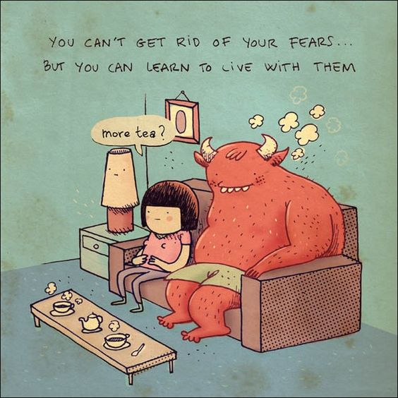
Integrative Behavioral Couples Therapy (IBCT)
Exposure Techniques
Dialectic Behavior Therapy (DBT)
Modeling
Behavioral Activation
Behavioral
Activation (BA)
Learning Principles
Functional Analytic
Psychotherapy (FAP)
Learning Principles
Acceptance-based strategies
Acceptance and Commitment Therapy (ACT)
Notes:
Concepts from learning psychology also play a role in more modern therapeutic approaches such as DBT, IBCT and ACT. These approaches share two core ideas: (a) that we need to focus on the link between environment-behavior if we are to change clinical behaviors and (b) unlike traditional BT, language and cognition also influence our behavior and should be included in one’s functional analysis.
These therapies do not emphasize the need to restructure or reappraise one’s thoughts or feelings: instead they focus on what ‘function’ those thoughts and feelings have for the individual, and how the environment gives rise to and sustains those functions. For instance, imagine a public speaker who has the thought “I’m going to have a panic attack” as she walks towards a podium. An ACT therapist might not assume that this thought is necessarily harmful or that it has to be eradicated or revised. Rather they might ask “How can you relate to this thought in a way that will foster what you want?”

Slide 55

Notes:
Summary. There is an idea at the core of many psychotherapies that originated in learning psychology. This idea was that problematic ‘clinical’ behaviors are the result of people’s ongoing interactions with the environment, and that these problematic behaviors can be modified by manipulating the link between environment and behavior. These therapies, along with the principles of learning and procedures they rely on, work: they help people suffering from a wide range of issues, from depression, ADHD, and OCD, to panic and anxiety disorders, fears and phobias. And some of the most effective treatment procedures in clinical therapies (like exposure techniques, behavioral activation, contingency management) are those that emerged from the learning psychology literature – once again highlighting the applied value of this area.

Slide 56


Notes:
Finally, let’s consider substance abuse. The principles of learning have also had a direct impact in this domain as well.
For instance, we now know that humans and non-humans will self-administer (R) drugs (Sd) such as cocaine, heroin, alcohol, nicotine, and marijuana, and that the physiological consequences of doing do (Sr) can exert overwhelming control over their behavior, regardless of the costs. Indeed, studies show that in situations where there is unlimited access to drugs and no other reinforcers, non-human animals will persistently self-administer them over-and-over again, even to the point of death…

Slide 57
https://www.youtube.com/watch?v=sbQFNe3pkss

Slide 58






Sr
Sd
R
Choice 1
Sr
Sd
R
Choice 2
Notes:
Drug addiction can be viewed as an operant behavior and drug use as a particular type of operant behavior (i.e., a choice between using a drug and not using a drug) (think back to your lesson on choice behavior in the operant learning section). Now from this perspective, there is a competition between the reinforcing (or punishing) consequences for using versus not using drugs. In the language of learning psychology, the relative reinforcing (or punishing) value of drug and non-drug stimuli exerts powerful control over a person’s choices.

Slide 59











ABSTINENCE REINFORCEMENT INTERVENTIONS
Voucher Procedures
Deposit Contracting
R
Sd
Sr
Establishing
Operation
Choice 1
Consequence
Choice 1
Choice 2
Choice 2
Notes:
If we view drug use as an operant behavior then drug abuse can be treated using what we learned in the laboratory on operant conditioning. For instance, contingency management treatments for drug addiction are one such example. These basically create operant contingencies that reinforce behavior that is incompatible with drug use. Let’s take two examples:
1.. Deposit contracting procedures require people deposit a certain sum of money prior to the program, and this amount can be earned back across time by demonstrating reductions in drug intake. Committing resources serves as a ‘contract’ between the person trying to quit and the clinician. The person’s own funds are used to reinforce abstinence along with social reinforcement.
2. Voucher-based procedures deliver vouchers (Sr) which can be exchanged for goods or services contingent on drug abstinence (R). Imagine, we were working with cocaine addiction. Participants in the program would have to provide biological samples (R) (e.g., urine) that are tested for the presence of the target drug. Biological samples provides an objective assessment of drug use outside the clinic, given that verbal reports of drug use are often unreliable because people will lie to gain access to reinforcers. The individual is reinforced when the test confirms the absence of the drug from their system. In this case through access to vouchers [conditioned reinforcers] that can be exchanged for money at a later time. Whenever the drug is present, reinforcers are withheld or punishers introduced (e.g., reset of the reinforcer value to a lower level).

Slide 60








Pregnant Mothers
Mental Health Problems
Adolescents
Contingency Management
Employees
Notes:
These types of interventions reduce drug use in many populations (e.g., pregnant mothers, adolescents, employees, health care professionals, and those with mental health problems), with a range of reinforcers (e.g., food, money, shelter, clothes), contingencies (e.g., intermittent vs. continuous reinforcement), contexts (e.g., clinics and workplaces), and types of drugs (e.g., cocaine, methadone use, cigarettes, heroin, marijuana, and alcohol).
Voucher-based reinforcement is one of the most effective treatment available for cocaine addiction, whereas CM is among the more effective approaches to promoting abstinence during and after drug treatment. This class of procedures not only reduces drug use but also promote adherence to taking prescribed medication, and increase retention in treatment programs.

Slide 62
Applied Learning Psychology:
at the Group Level
Notes:
So far we have seen how the concepts outlined in this course can be used to improve the lives of individuals with developmental disabilities, mental health problems, or addictions. But the question is: can we use those same concepts to influence the behavior of groups as well?

Slide 63
Applied Learning Psychology at Home
Notes:
Take families. We can influence the contingencies that shape family life, and as a result, how parents and children thrive and develop.

Slide 64







Coercion: control of behavior through (a) punishment or threat of punishment, or (b) negative reinforcement (i.e., the removal of a punisher).
Sd
R
Sr
Ok – stop. I’ll do it
If you tried harder I wouldn’t do so
You’re always criticizing me
Hits Brother
Runs away
‘You’re stupid ‘
‘Clean your bedroom’
Notes:
Coercion refers to the control of behavior through (a) punishment or threat of punishment, or (b) negative reinforcement (i.e., the removal of a punisher).
Coercion can influence family behavior in many ways:
1. One child might tease or criticize another, and the second might do the same. Because neither child finds such behavior appetitive, they get angry, shout, or hit (R) and this ends (negatively reinforces) the entire interaction (Sr).
2. A parent might request that the child engage in some activity (R) (e.g., clean bedroom), causing the child to respond aversively (Sr) (e.g., scream) in an attempt to avoid that behavior. If the child is “successful,” and the parent backs down, then two things occur: (a) avoidance of the unwanted behavior reinforces the child’s aversive responding, and (b) the termination of the child’s aversive behavior reinforces the mother’s backing down.
3. The same pattern often emerges in marital conflict – romantic partners often respond to each other’s verbal criticisms (Sd) with their own nasty reactions (R). The same cycle of negative reinforcement occurs when one person occasionally escalates their angry behavior and this temporarily puts a stop to their partner’s unpleasant behavior (Sr).

Slide 65



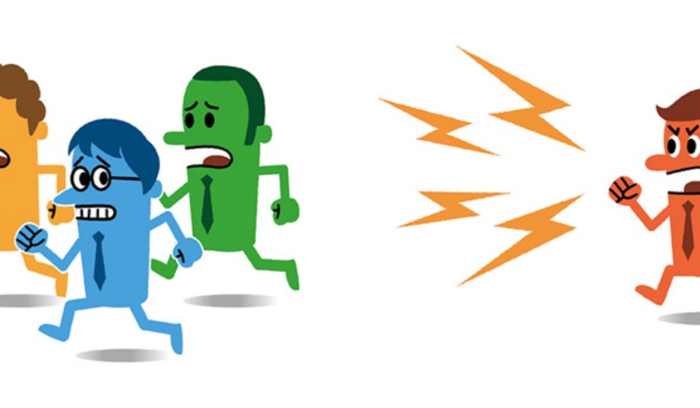





Age 5
School
Adults
Adolescence
Conflict, divorce, & poor parenting
Aggressive behavior
& poor prosocial skills
Problems with teachers and learning, peers avoid
Prosocial skills
Learning more & more friends
Notes:
Although learning to control the behavior of others via coercion might be effective in the short-term, it can be devastating pattern to fall into in the long-run. Researchers followed a sample of aggressive and nonaggressive children into adulthood (Capaldi, Pears, and Kerr 2012). They found that patterns of coercion learned within the family gave rise to aggressive children (by the age of five) who were quick to be aggressive and who had a deficit of pro-social skills like cooperation and impulse control - skills that were found in the families of nonaggressive children.
At school, aggressive kids were uncooperative with teachers and did not learn as much as their prosocial counterparts. They actually annoyed other kids who actively avoided them. When they reached high-school, they were falling behind in school and had fewer friends. The conflict created at home meant that their parents had given up trying to check their adolescent behavior or set limits on their activities. So they were free to interact with other aggressive teenagers. These groups further trained multiple problem behaviors. As adults, the aggressive kids were more likely to have conflict with their romantic partners, get divorced, and raise children with similar problems…thus continuing the same cycle.

Slide 66
https://www.youtube.com/watch?v=Qj9iFmPOV6Q

Slide 67
Problem. The mother wants her 2 year old child to sleep in his own bed. However, he starts crying every time she puts him to bed. If he cries then the mother takes him out of bed and brings him downstairs to watch TV. Sometimes she gives in and lets him come down. Other times she is consistent. It now takes 2 hours to put him to sleep.
Question 1: What stimuli might be triggering and maintaining her child’s behavior?
a. Sd (presence of child) → R (mother letting him downstairs) → Sr (stops his crying)
b. Sd (being alone in a bed) → R (Crying) → Sr (stops his crying)
c. Sd (presence of mother) → R (Crying) → Sr (access to TV)
d. Sd (absence of father) → R (Crying) → Sr (access to TV)
Notes:
Option a. seems like the contingency that is influencing the mothers behavior. But the behavior we are interested in is the child’s. Thus in this case option a is incorrect. Being alone in the bed is not a stimulus that signals that crying will lead to him stopping crying so option b is incorrect. The presence of the mother in the video was a signal that if the child cries he will gain access to the TV. So option c is an acceptable answer. The absence of the father AND the presence of the mother might signal that crying will be consequated with access to TV. But the absence of the father (and thus absence of a parent) will not result in access to the TV if one cries thus option d in this case is incorrect.

Slide 68
Problem. In the video the mother sits beside the child’s bed and ignores his crying behavior.
Question 2: What type of procedure is this?
a. Shaping
b. Extinction
c. Counter conditioning
d. Imitation
Notes:
By sitting beside the child and ignoring his crying behavior the mother is terminating the relationship between crying (R) and gaining access to the TV (Sr). So she is utilizing an extinction procedure.
Note that by sitting beside the child and not reacting the child learns this relationship quicker than if she leaves the bedroom (in such a case the child is uncertain if the Sd (mother) that signals that the R (crying) will lead to the Sr (TV) is present.

Slide 69
Problem. In the video the child’s crying and screaming increase when the mother ignores his behavior.
Question 2: What is this increase in the intensity and variability of behavior at the beginning of an extinction procedure known as?
a. Reinforcement
b. Punishment
c. Extinction Burst
d. The child being frustrated
Notes:
Extinction burst is the answer. We covered this during the section on extinction during the operant conditioning lectures. This period of variability is a good time to introduce a new shaping procedure to replace the original (problematic) contingency with a new one.

Slide 70
Problem. When the child cried in the past, the mother sometimes let him watch tv and other times put him to bed and ignored his cries.
Question 4: This is an example of which type of reinforcement schedule?
a. Variable Ratio
b. Fixed Ratio
c. Variable Interval
d. Fixed Interval
Notes:
In this example access to the reinforcer (TV) depends on how much the child behaves (i.e., how much he works). Thus it is a ratio schedule and not an interval schedule (which depends on when one works). Access to the TV does not come every time he cries – only from time to time. Therefore it is a variable ratio schedule.

Slide 71
Problem. When the child cried in the past, the mother sometimes let him watch TV and other times put him to bed and ignored his cries. When she tries to put his crying behavior into extinction and shape up a good bedtime routine, it takes a long time. Even longer if she had consistently put the child to bed.
Question 4: So what unit has the parent shaped up in the child:
a. Cry once to gain access to the TV
b. Cry many times to gain access to the TV
c. Go to bed to gain access to the TV
d. Watch TV to go to bed
Notes:
If the parent continuously reinforced the child’s behavior (i.e., provided access to the TV every time he cried) then the relationship to be extinguished is “cry once to gain access to the TV”. But because the parent reinforced the child’s behavior from time to time (partially) then the relationship that now has to be extinguished is “cry many times to gain access to the TV”. Thus while a consistent extinction procedure might be more difficult for parent and child in the short term it is better for both in the long term. The opposite is true for partial reinforcement and extinction procedures.

Slide 72





BEHAVIORAL PARENT TRAINING
Sd
R
Sr
Cries
‘Great-Job! Here’s some candy’
‘I want candy’
Verbal or Physical
Time-out
Notes:
From a learning psychology perspective, in order to change the behavior of children, parents, and partners, we first have to change the environment they are embedded in. We can do this by establishing contingencies that reinforce prosocial interactions and disrupt coercion.
One way to do this is by having parents take part in Behavioral Parent Training (BPT). BPT involves establishing contingencies between the parent and child that influence the child’s behavior for the better. These programs teach parents to avoid coercive practices (e.g., anger, criticism, or physical deterrents) that punish unwanted child behavior. Instead they are taught to reinforce desired behaviors (e.g., reinforcement of prosocial behavior, withdrawal of attention for misbehavior through the use of ignoring or time-out).
The cool thing is that these programs seem to work: parents who took part in one BPT program saw lower rates of child aggression in the following nine years, child maltreatment by parents, foster care placements, and improvements in marital relationships.

Slide 74
Applied Learning Psychology:
at School
Notes:
What about schools?

Slide 75



COERCION IN SCHOOLS
Sd
R
Sr
Disruptive behavior
Attention
Stop Disruption
Difficult or Boring Task
Disruptive behavior
Avoid Task
Notes:
Creating high functioning schools basically involves setting up similar conditions as we did in the family:
Get rid of patterns of coercion. Teachers often pay more attention to problem students than to their well-behaved counterparts because (a) problem students interrupt the lesson, and (b) doing so is reinforcing (i.e., if the problem student complies with the teacher’s command, the termination of the problem behavior increases future punitive action from the teacher).
But attention from the teacher can also reinforce the student’s problematic behavior, setting up a pattern of coercion like we saw in the family.

Slide 76




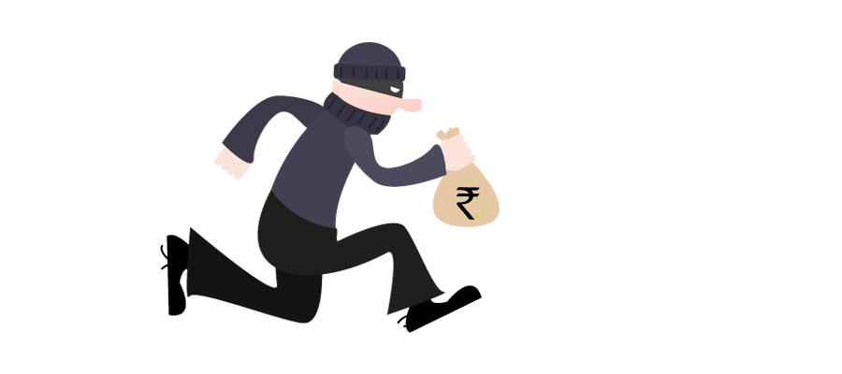


GOOD BEHAVIOR GAME
Sr
R
Sd
“You can earn a point by listening when I speak”
“You will get a ‘foul’ when you get out of your seat”
1. Specifies contingencies that will be reinforced in the classroom (Reinforcement)
2. Specifies contingencies that will be punished in the classroom (Punishment)
3. Signals game at certain times and not others (Stimulus Control)
4. Divides students into groups (Competition and Group level contingencies)
5. Scoreboard (Feedback)
Notes:
Teachers can avoid these problems and create a productive learning environment by adopting a different strategy. Consider, for example, the Good Behavior Game (GBG). In this game, the teacher specifies the contingencies that will be reinforced and punished in the classroom (i.e., put into extinction) and the consequences for acting in this way (i.e., punishers or “fouls”). Examples of both are presented so that students can form response classes and learn what will eventually evoke reinforcement or punishment. The teacher also implements the game at certain times but not others. Children are divided into groups (so that group level contingencies can operate on and shape the behavior of the individual) and the groups with the least “fouls” gain access to some reinforcer. A scoreboard is presented which allows each group to keep track of their own and other groups performance.
The really cool thing about this simple game is that, in more than fifty studies in all sorts of classroom settings, it promotes prosocial behavior, reduces disruptive behavior, and teacher distress. It often leads to better performance than other options. Longitudinal data indicates that those who played the GBG as children were less likely to be arrested or become smokers later on in adolescence, and less likely to be addicted to drugs, suicidal, or have committed crimes in adulthood.

Slide 77
Applied Learning Psychology:
at Societal Level

Slide 78

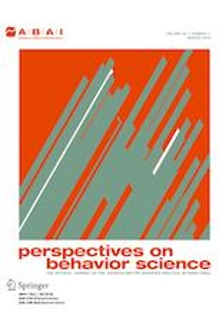
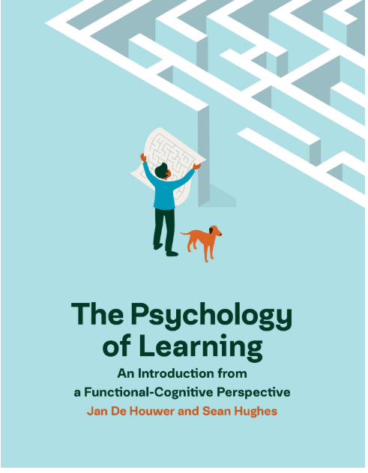
Chapter 5 (Course Handbook)
Perspectives on behavior science
De Houwer & Hughes (2020)
Notes:
So far, we have seen how concepts from learning psychology can be used to improve well-being at the individual and group levels. Yet their potential goes even further. We could use those same concepts to shape the behavior of corporations, governments, and societies in ways that ensure that most people are healthy, productive, and caring.
Such an approach requires that we move our attention from individuals, families, and schools to entire populations. Unfortunately learning psychology has not been good at influecing behavior at the societial level. For some examples of what this might look like see Chapter 5 of your course handbook, the Psychology of Learning book (De Houwer & Hughes, 2020) or a journal known as perspective on behavior science.

Slide 79
Conclusion

Slide 80
Behavioral Problem
Regularities & Principles
Functional Analysis
Behavior Change

Slide 81


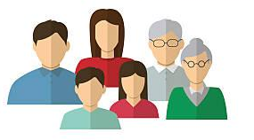
Autism
Clinical Problems
Learning Psychology
Addiction
Families & Schools

