Slide 1
Key from previous lesson
1. Learning = effect of regularity in environment on behavior
=> is hypothetical explanation of behavior
=> is an effect, not a mental process
2. Three forms of learning that refer to three types of regularities + complex learning
3. Two complementary questions about learning:
- What aspects of environment moderate learning?
- What mental processes mediate learning?

Slide 2
Er
∆B
Moderation: Learning effect depends on
Type of stimuli
Type of behaviour
Type of organism
Characteristics context
Nature of Er

Slide 3
Mediation:
Er
Mental
processes
∆B

Slide 4
Exercise Question 5: A patient suffers from hysteria because she used to be sexually abused by her father. This is a:
1. functional explanation
2. Freudian explanation
3. cognitive explanation
4. neurological explanation
Notes:
🍐 This is a Pear Deck Multiple Choice Slide. Your current options are: A: functional explanation, B: Freudian explanation, C: cognitive explanation, D: neurological explanation,
🍐 To edit the type of question or choices, go back to the "Ask Students a Question" in the Pear Deck sidebar.

Slide 5
Exercise Question 6. Which of the following alternatives offers a (possible) functional explanation for why Product A sells more than Product B?
1. Product A is more strongly associated in memory with positive concepts than Product B.
2. Product A meets people's needs better than Product B.
3. Product A is more often seen on TV than Product B.
4. None of the above
Notes:
🍐 This is a Pear Deck Multiple Choice Slide. Your current options are: A: Product A is more strongly associated in memory with positive concepts than Product B, B: Product A meets people's needs better than Product B, C: Product A is more often seen on TV than Product B, D: None of the above alternatives is correct,
🍐 To edit the type of question or choices, go back to the "Ask Students a Question" in the Pear Deck sidebar.

Slide 6
Chapter I
EFFECTS OF
REGULARITIES IN THE PRESENCE OF A SINGLE STIMULUS

Slide 7
I.1. Functional knowledge
I.1.1. Nature of the stimuli
1) general: sounds, visual stimuli, ... (e.g., habituation as effect: VIDEO)
2) yet impact of nature of stimuli:
- on speed of effect: habituation slower for "significant" stimuli
e.g. affective vs neutral images
e.g. anxious cry of a peer: faster recovery after habituation (biological significance)

Slide 8
Neutral stimulus
OR
Affective stimulus
# presentations

Slide 9
- on the direction of effect: very intense stimuli lead to sensitisation = opposite effect: increase in intensity of reaction (see figure)
3) Effects not limited to stimulus presented => generalisation: Stimulus A (e.g., tone 100 Hz) also affects the response to similar stimuli (e.g., tone 80 Hz)

Slide 10
OR
Neutral stimulus
Very intense stimulus
# presentations

Slide 11
I.1.2. Nature of behavior
1) general: changes in intensity of response, liking, responses of spiders, slowing down classical conditioning, ...
2) in lab usually change Orientation Response (OR)
- different components: increase in skin conductance, decrease in heart rate, EEG
- habituation rate differs from component to component (e.g., heart rate faster than skin conductance)

Slide 12
- interactions between nature stimuli and nature behavior:
°No difference in habituation heart rate between
neutral and affective images
°Difference in habituation skin conductance
between neutral and affective images

Slide 13
Heart rate response
Skin conductance response
Intensity
response
Intensity
response
neutral
significant
neutral
significant
number of presentations
number of presentations

Slide 14
3) Reaction vs counter-reaction: decrease in reaction intensity but increase in counter-reaction intensity
eg: - smoking
- jogging
= dynamics of affect
=> nature of observed behavior has influence on effects of non-contingent stimulus presentations

Slide 15
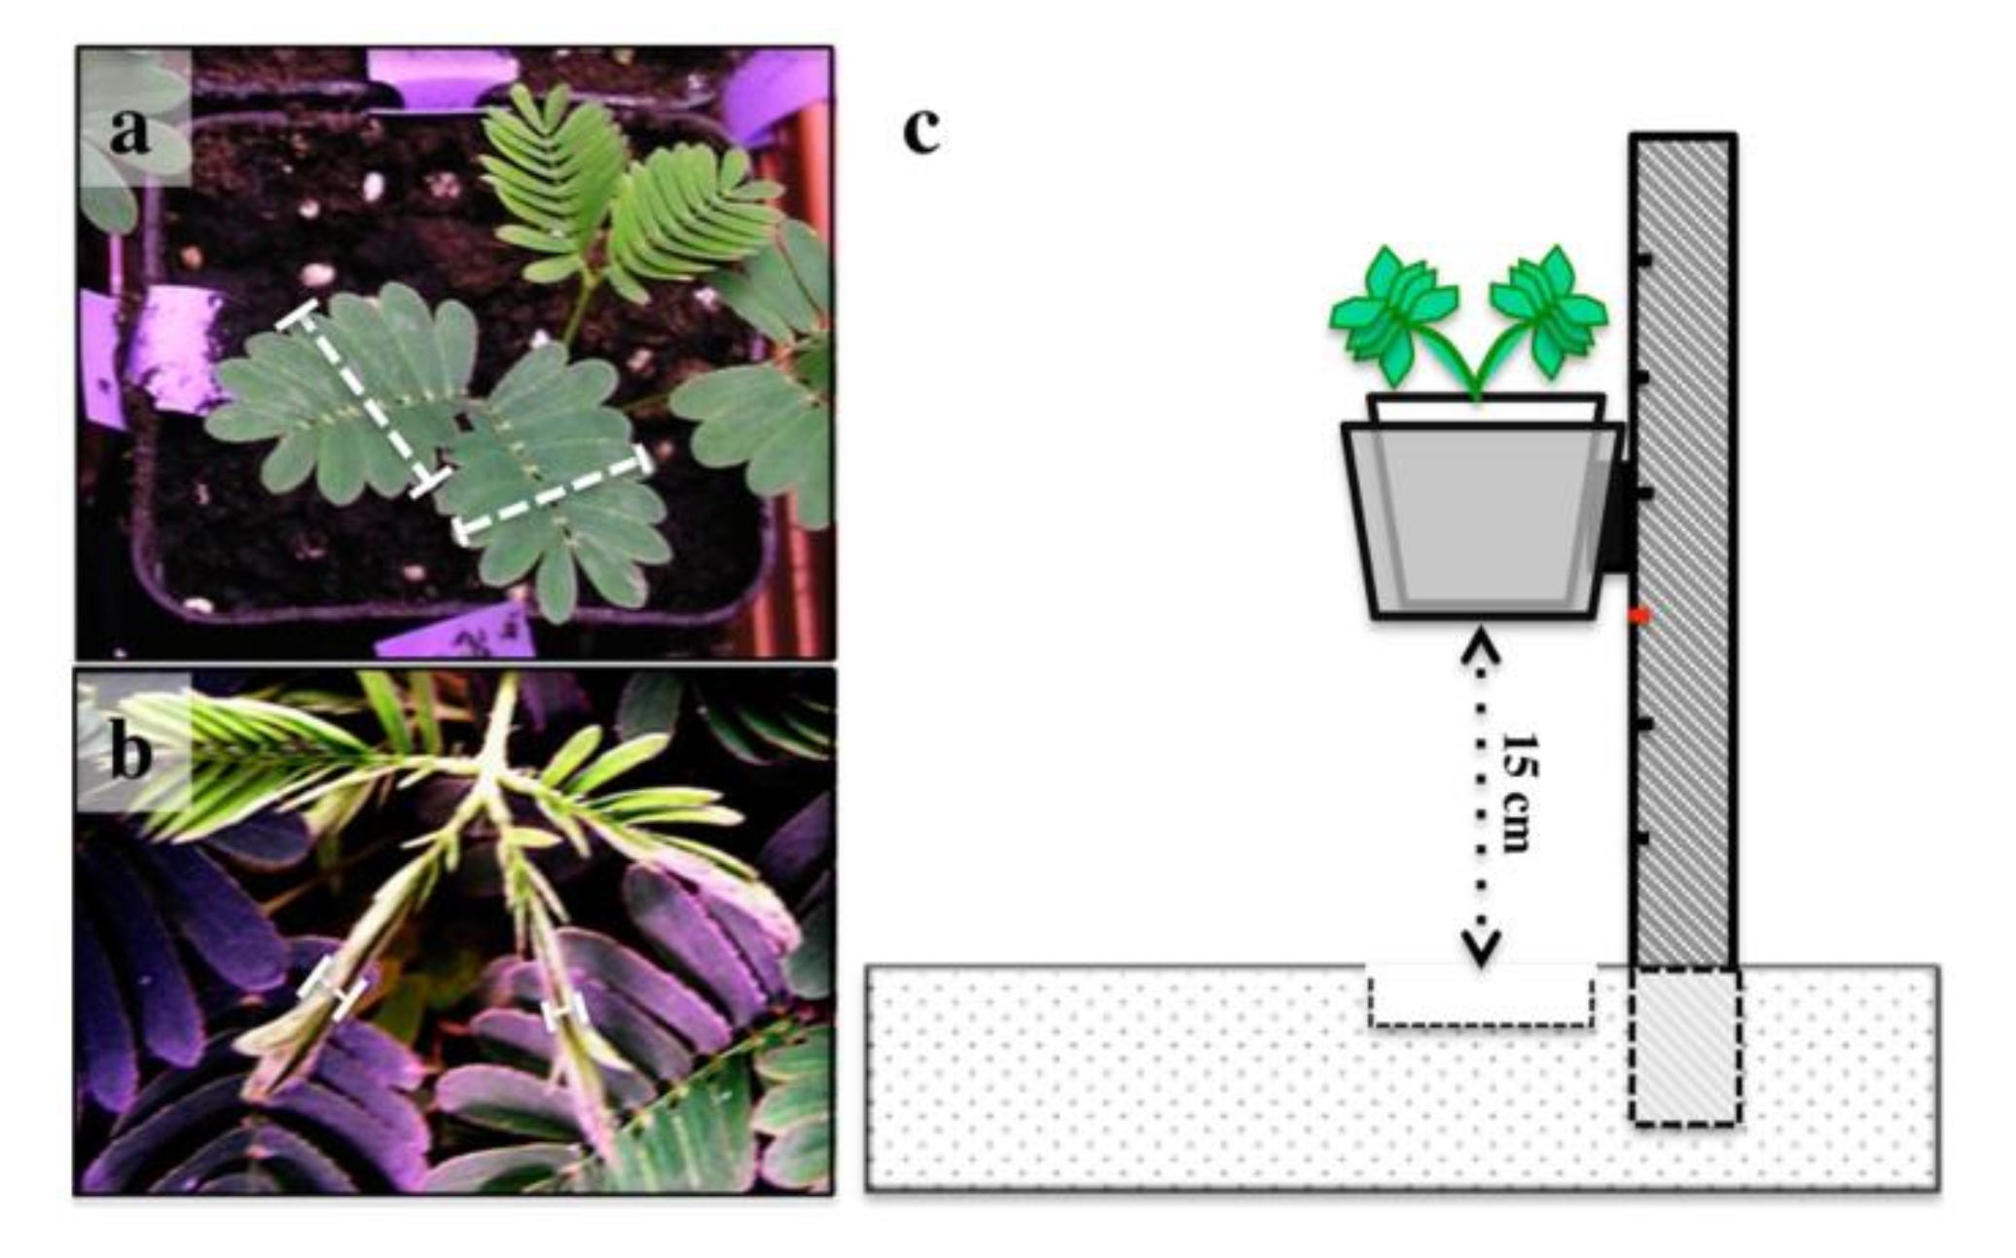
I.1.3. Nature of the organism
- General (influence on all kinds of organisms)
- but may modulate effect nature of stimuli and nature of behavior (e.g., biological relevance)

Slide 16
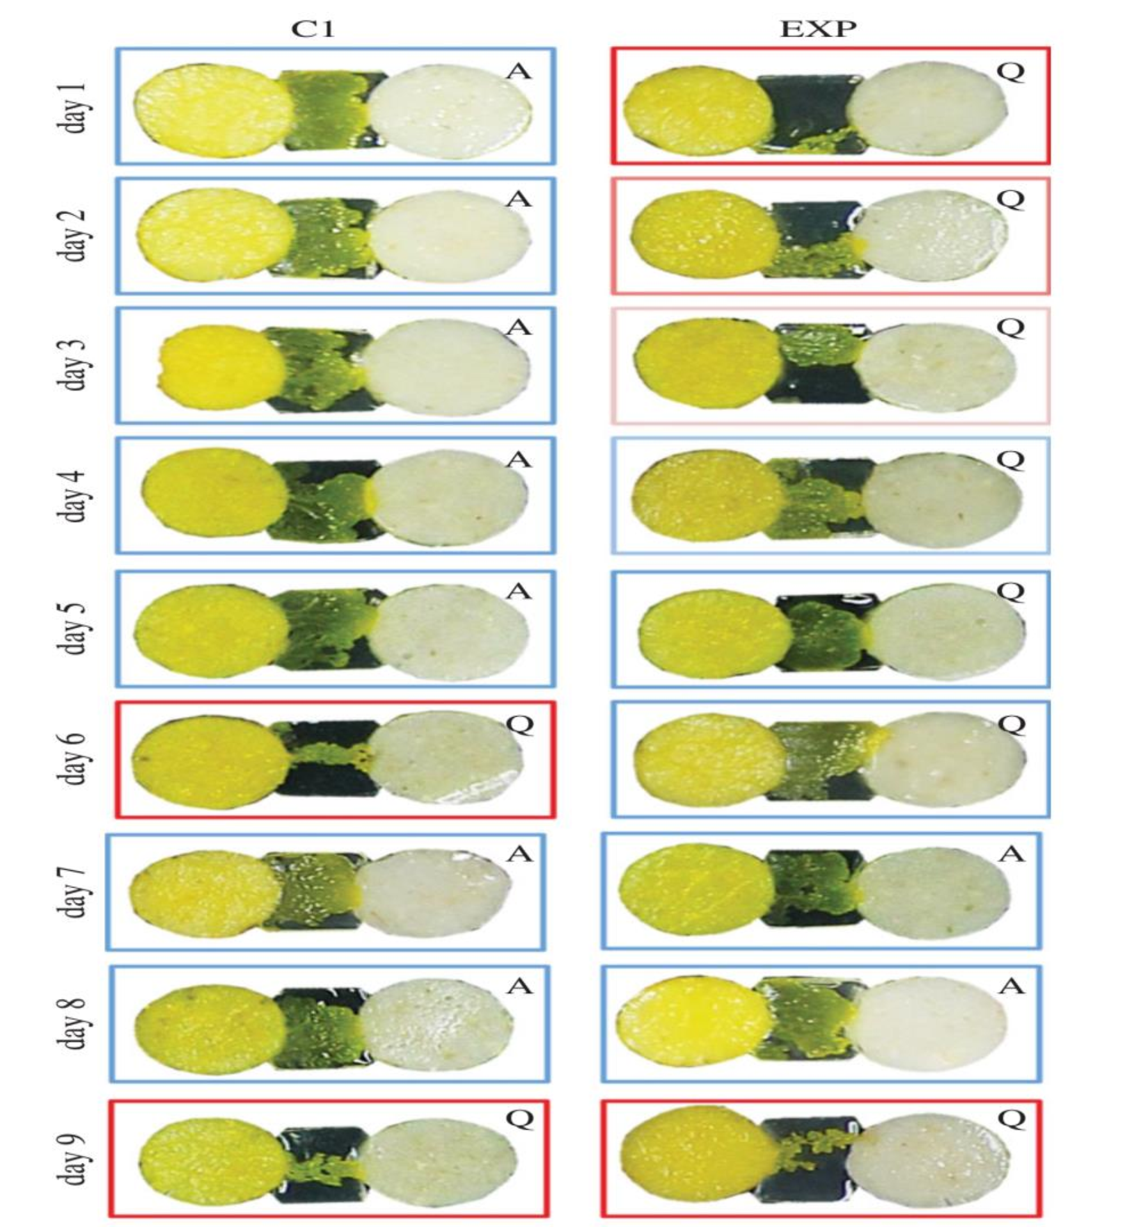

Slide 17
I.1.4. Broader context
- little examined
- 1 example: Diverting attention helps habituation (e.g., loud bang during concentration test)
I.1.5. Characteristics of non-contingent presentations
= Impact how stimuli are presented
I.1.5.1. The nature of the non-contingent stimulus presentation (key statistical features):
e.g. number of presentations counts and not only the first one

Slide 18
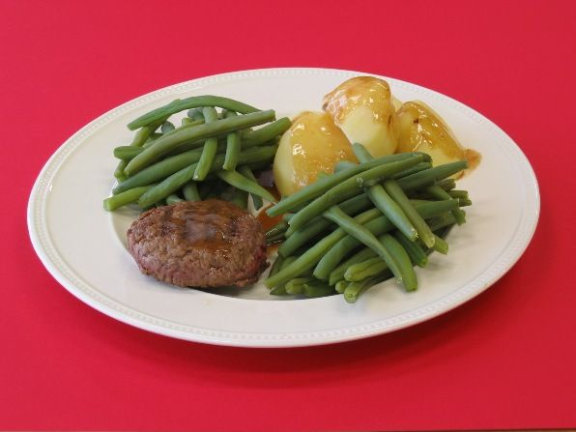
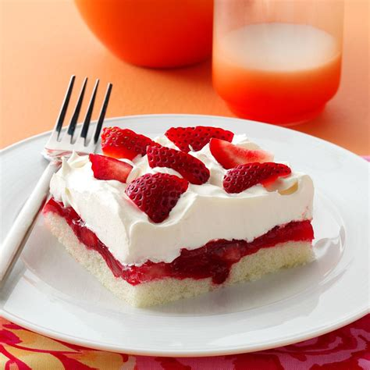
I.1.5.2. Changes in the nature of the regularity
- dishabituation: Partially undo habituation effect by presenting other stimulus (i.e., by breaking regularity => VIDEO)
- Epstein: dishabituation and eating behaviour
I.1.5.3. Temporal aspects: When present stimulus?
- massed vs distributed: faster but less sustainable when massed than when distributed

Slide 19
Exercise Question 7. Suppose that a rat's response to an electric shock becomes more intense because of the more frequent administration of the electric shock. This is an example of
A. classical conditioning
B. Habituation
C. Non-contingent stimulus presentations
D. none of the above
Notes:
🍐 This is a Pear Deck Multiple Choice Slide. Your current options are: A: classical conditioning, B: habituation, C: non-contingent stimulus presentation, D: none of the above,
🍐 To edit the type of question or choices, go back to the "Ask Students a Question" in the Pear Deck sidebar.

Slide 20
I.2. Process theories
I.2.1. Habitution OR: Sokolov and Bradley
1. Model of Sokolov (1975)
(a) assumptions

Slide 21
(b) Explanation of functional knowledge?
- explanation of habituation + OR when stimulus unexpectedly no longer presented
- no explanation for effect of nature of stimuli, nature of behavior, and interaction between the two

Slide 22
2. Bradley's model (2009)
(a) assumptions
- OR depends not only on novelty but also significance
- repeated presentations have more impact on novelty than on significance
- some OR components depend more on novelty, some more on significance

Slide 23
Previous stimulus presentations
Novelty?
S
OR
Significance?
Black box

Slide 24
(b) Explanation of functional knowledge
- nature of stimuli: less effect of presentations on significance, thus slower habituation to significant stimuli
- nature of behavior: less effect of presentation on significance, thus slower habituation for significance components (e.g., skin conductance)
- interaction nature stimulus x nature behavior
  *OR components that reflect novelty only: no effect nature stimuli
  *OR-components that reflect novelty and significance: effect of the nature of stimuli

Slide 25
I.2.2. Opponent process theory: Solomon
=> Effects of non-contingent stimulus presentations on reactions and counterreactions (dynamics of affect)
1. Functional knowledge that the model seeks to explain:
Repeated presentations of stimuli weaken the reaction and strengthen the counterreaction (e.g. smoking, jogging)
=> studies in lab with dogs

Slide 27
2. Assumptions: Two opponent processes
(a) A process
- unconditional " response "
- remains stable
(b) B process
- unconditional “counter-response”
- gets stronger + starts faster + lasts longer
(c) Observable behaviour is the sum of two
3. Explanation change in dynamics or affect:

Slide 28
Previous stimulus presentations
A process
S
R
B process
Black box

Slide 29
Examples: smoking, jogging (kick, craving, tolerance)

Slide 30
4. Additional assumption: Conditioning of b-process
=> stimuli that go together with the b-process later on stimulate the b-process (and thus craving)
=> explanation new functional knowledge
(a) context-dependence of relapse and craving
- external stimuli: e.g., home/work
- internal stimuli: e.g., when tense
(b) context-dependence of tolerance
(c) treatment
- cold turkey
- cold turkey + exposure
- cold turkey + exposure + coping

Slide 31
stimuli that co-occur with b-process
A process
S
R
B process
Black box

