Slide 1
CHAPTER II.
CLASSICAL CONDITIONING
THE EFFECTS OF REGULARITIES IN THE PRESENCE OF TWO STIMULI
Notes:
1

Slide 2
Course Overview:
0. Introductory chapter: What is learning and how to study learning?
I. Effects of non-contingent stimulus presentations
I.1. Functional knowledge
I.2. Mental process theories
II. Classical conditioning
II.1. Functional knowledge
II.2. Mental process theories
III. Operant conditioning
III.1. Functional knowledge
III.2. Mental process theories
IV. Complex forms of learning
V. Applied Learning Psychology

Slide 3
II.0: Some basic terms and procedures
II.0.1. Basic terms
CS, NP, US CR
cue, A, X, T.... outcome... judgment
S -------- S => R
- tone - food - salivation
- light - shock - GSR
- cause - effect - judgement
- predictor - event - judgment
- photo - photo - evaluation
…

Slide 4
A+: CS A is followed by the US (e.g. Tone - food) = CS - US
A-: CS A is not followed by the US
(e.g., Tone- no food) = CS-only
AB+: CS A and CS B are presented together and followed by US
(e.g., Tone+light - food) = compound cue
AB-: CS A and CS B are presented together and not followed by the US
A+, AB+: CS A is first presented alone and followed by US, then CS A together with CS B and followed by the US.

Slide 5
II.0.2. Procedures
1. Pavlov:
- food (US) => salivation (UR)
- buzzer(CS) - food(US)
=> CS elicits salivation (CR)
=> rarely used (impractical)
2. Eye Blink Reflex
- air puff in eye(US) => blink reflex(UR)
- tone (CS) - air puff (US)
=> CS elicits blinking
- more convenient because automated procedure
Notes:
5

Slide 6
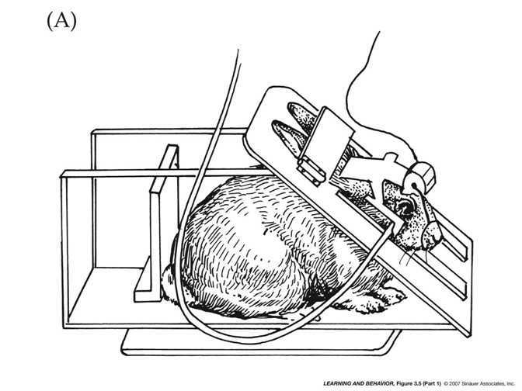
Notes:
6

Slide 7
3. Fear Conditioning
- Shock (US) => pain
- Figure (CS) - shock (US)
=> CS evokes fear (CR) < > UR
=> different indices of index fear
° skin conductance
° suppression (see figure + VIDEO)
Notes:
7

Slide 8
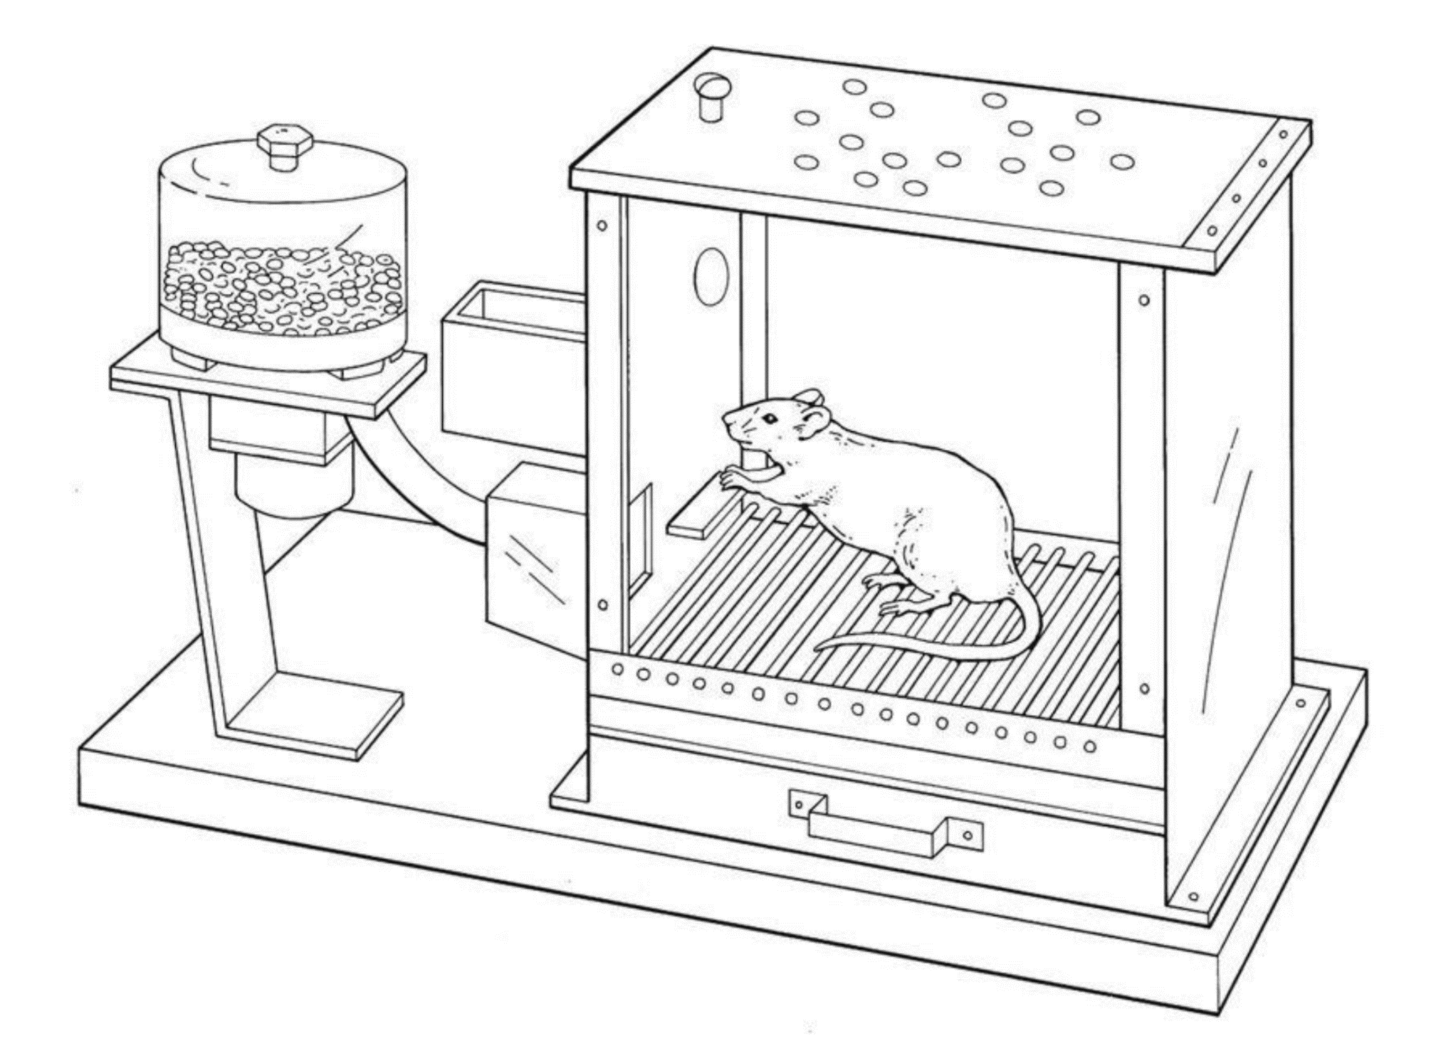
Notes:
8

Slide 9
II.1. Functional knowledge
What aspects of procedure moderate CC (the effect of regularities between stimuli on behavior)?
II.1.1. Nature of the incentives
II.1.1.1. Classical cond is general phenomenon
* bell-food => salivation
* also non-biologically relevant stimuli
* observational conditioning: social stimuli
CS = snake
US = fear response of conspecific to the snake
CR = fear response to snake

Slide 10
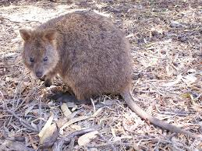
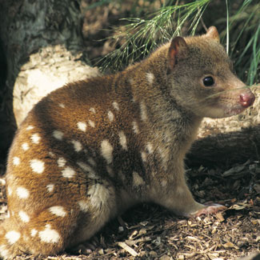
Quokka
Quolls
Askew et al. (2014)
Social learning: Effect of regularity of which
behaviour of others (socius) is 1 element
behavior observer is not an element
= is learning by others (not about others)
Notes:
10

Slide 11
* instructional conditioning: verbal stimuli
eg "triangle will be followed by shock"
=> fear of triangle
=> effects are very similar to those of CS-US paring
= probably more than words occurring together
(see Chapter 4 on complex learning)
I.1.1.2. The influence of the characteristics of the CS, US, and the relationship between the CS and US
- salience (intensity, relevance) CS and US
- intrinsic relationships: INTERACTION CS x US
=> anecdote Seligman: aversion
shows selectivity with which contingencies are learned
Notes:
11
T=tone; L=light; eyelid conditioning

Slide 12

Aversion learning in chemotherapy

Slide 13
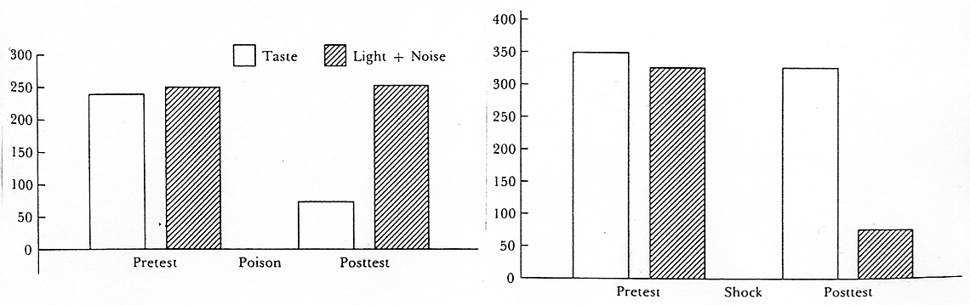
Garcia & Koelling (1966)
- leather: Taste and Light/Noise (CSs)
Cond 1: US = Lithium chloride (poison)
Cond 2: US = Shock
- test: drink with taste (K?) OR light/noise (L?)
- result: interaction nature CS and nature US
= KL+

Slide 14
II.1.1.3. The impact of the nature of the US on the nature of the CR
- appetitive US => appetitive CR (e.g., salivation)
aversive US => defensive CR (e.g., freezing)
!!! but CR may differ from UR; e.g., anxiety, drugs; see also VIDEO conditioned suppression!!!
- change in US:
*valence US: US evaluation (e.g., make food bad)
*Type of US: counter-conditioning: CS-shock then CS-food
CS
(3)
(2)
(CR)
UR
US
(1)

Slide 15
US revaluation effect:
Faze 1:
bell (CS) - food (US)
=> the bell afterwards elicits salivation
Faze 2:
food - nausea
=> food becomes aversive
Test:
bell (CS)
=> bell doesn’t elicit salivation anymore

Slide 16
Counter-conditioning effect:
Faze 1:
bell (CS) - food (US)
=> the bell afterwards elicits salivation
Faze 2:
bell (CS) - shock (US)
=> the bell does not elicit salivation anymore

Slide 17
Conclusion about the role of the nature of stimuli
- CC performs with a lot of stimuli
- still faster / stronger with certain CS, US, and CS-US combinations
- (Changes in) nature of US affect nature of CR

Slide 18
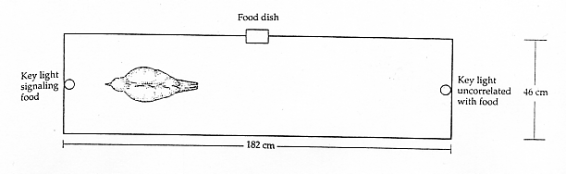
II.1.2. The nature of the observed behaviour
II.1.2.1. Influences on involuntary and random behavior
- autoshaping:
light - food => change in pecking (see VIDEO)
- dysfunctional / not instrumental (light as food? => see VIDEOs)

Slide 19

II.1.2.2. Three types of behaviour
- preparatory / consummatory responses:
prepare for US (but not always useful)
eg. Pavlov's dog, phobias

Slide 20

- contingency judgments:
eg. Food allergy
"Mr. X. eats strawberries (CS) and gets allergy (US)"
=> judgement on strawberry allergy link (CR)

Slide 21
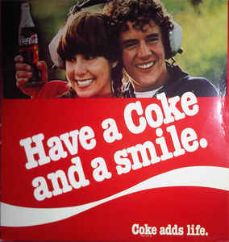
- evaluative conditioning
eg. Photo, taste-taste

Slide 22
Exercise Question 8: Suppose a tone and a light are presented together and are always followed by an electric shock. It is observed that these pairings have more impact on the fear elicited by the tone than the fear elicited by the light. This observation
A. in itself says nothing about learning
B. provides evidence for the role of intrinsic relationships in classical conditioning
C. is an example of the dynamics of affect
D. provides evidence for the role of the nature of CS in classical conditioning
Notes:
🍐 This is a Pear Deck Multiple Choice Slide. Your current options are: A: by itself says nothing about learning, B: provides evidence for the role of intrinsic relations in classical conditioning, C: is an example of the dynamics of affect, D: provides evidence for the role of the nature of the CS in classical conditioning,
🍐 To edit the type of question or choices, go back to the "Ask Students a Question" in the Pear Deck sidebar.

Slide 23
Exercise Question 9: From the perspective of functional learning psychology, contingency judgments are
an index of conscious knowledge
an index of conscious or unconscious knowledge
a form of behavior
a regularity in the environment
Notes:
🍐 This is a Pear Deck Multiple Choice Slide. Your current options are: A: an index of conscious knowledge, B: an index of conscious or unconscious knowledge, C: a form of behavior, D: a regularity in the environment,
🍐 To edit the type of question or choices, go back to the "Ask Students a Question" in the Pear Deck sidebar.

Slide 24
Box 2.2. Respondent vs. classical conditioning
Functional psychologists:
talk about respondent conditioning
Respondent behavior = ONLY function of antecedents
Operant behavior = function of consequences
Respondent conditioning = impact of S-S relationship on respondent behavior
=> operant behaviour is thus excluded
=> very little behavior is purely respondent
HENCE respondent conditioning not important

Slide 25
Cognitive psychologists: Classical conditioning is learning to know contingencies and thus predict environment
= crucial mental process
= easier to study than operant cond.
=> Classical conditioning is very important
Functional-Cognitive framework: Classical cond is impact S-S regularity regardless of type of behavior: regularity is central and thus not limited to purely respondent behavior
=> e.g. judging contingency = is operant but content of judgement can be determined by S-S contingency

Slide 26
II.1.2.3. Unconscious learning: The relationship between different conditioned changes
Functional approach: not about unconscious mental process but impact on judgment vs. other behavior
=> first change in judgment, then other CRs
=> e.g. Dawson: tone-shock => only change in skin conductance when aware of tone-shock relation
So: no unconscious learning?!:
=> Discussion on "unconscious" learning continues

Slide 27
Conclusion II. 1.2 Influence nature of behavior:
CC is general: involuntary and voluntary behavior, different types of behavior, but only after conscious judgement.

Slide 28
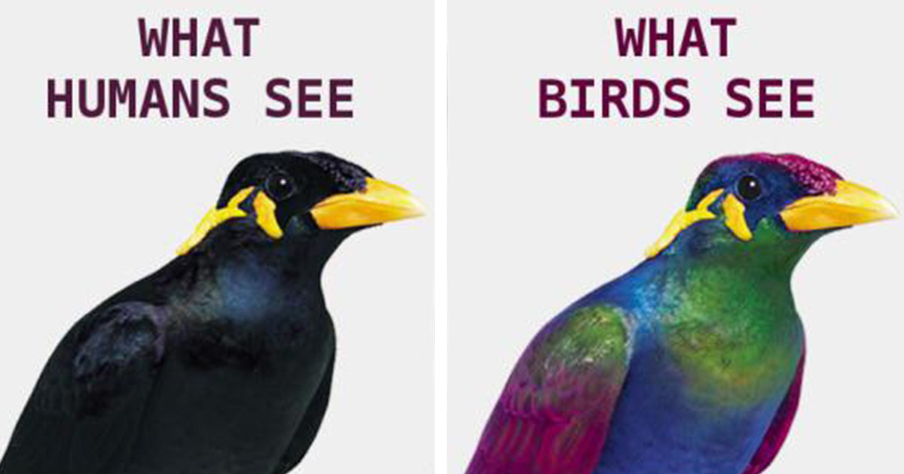
II.1.3. The properties of the organism
general (humans to worms) VIDEO
but each in its own way: convergent evolution
but nature of the organism determines which contingencies are (quickly) learned (e.g., mammals: taste-fear; birds: color-fear)

Slide 29
conditioning as adaptive adaptation:
Evolutionary perpective
  1. Perspective: conditioning is a function of survival and reproduction
  => is an adaptive effect that occurs in natural situations
  2. Consequence of perspective:
  a) Work with 'ecological CSn': CSn that may occur with US in natural situations
  (b) Look for adaptive effects

Slide 30
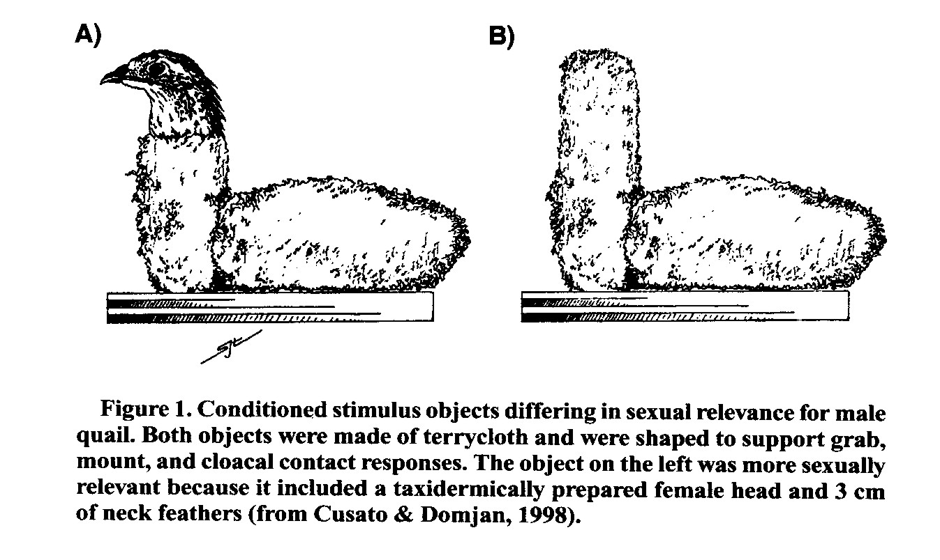
Ecological CSn
- examples: Aversion learning, sexual conditioning in quail.

Slide 31
- conditioning with ecological CSn seems to have distinct characteristics (see also aversion; attempted mating only with ecological CS)
- but results still unclear + how to determine on an a priori basis whether CS is 'ecologically valid'?

Slide 32
(b) Adaptive effects: Better coping with key stimuli/events.
=> thus changes in UR
- e.g.: sexual conditioning leads to more efficient copulation after seeing CS (time, sperm count, probability of fertilization)
- e.g.: conditioned drug tolerance
=> conditioning to understand plasticity of all kinds of biologically relevant functions (e.g., dieting)

Slide 33
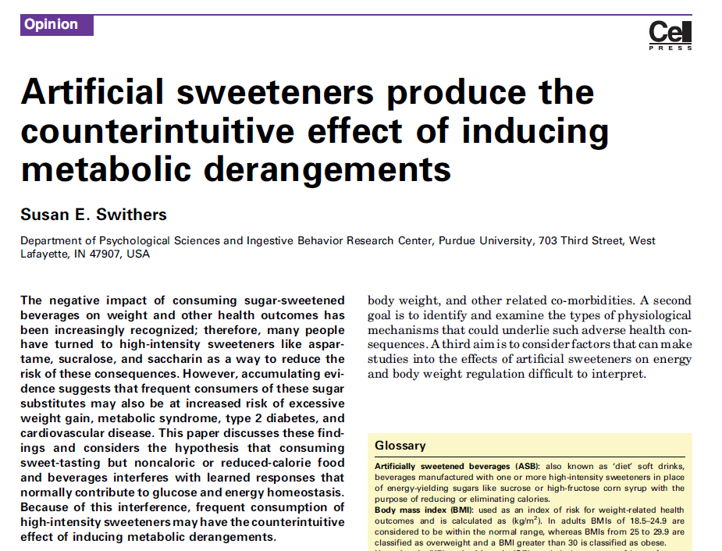
Trends in Endocrinology and Metabolism, September 2013, Vol. 24, No. 9

Slide 34
II.1.4. The influence of the broader context
Broader context = other events in the environment (e.g., other regularities)
- secondary task: weakened CC
- Focus on CS-US link: strengthened CC
Interim conclusion: CC very general but is modulated by nature stimuli, nature behavior, nature organism, and broader context

