Slide 1
Course Overview:
0. Introductory chapter:
I. Effects of non-contingent stimulus presentations
II. Classical conditioning
II.1. Functional knowledge
II.2. Mental process theories
II.2.1. Associative models
II.2.1.1. S-R models
II.2.1.2. S-S models
general (what + evaluation)
Rescorla-Wagner
Wagner & Bouton
Comparator
II.2.2. Propositional models
III. Operant conditioning
IV. Complex forms of learning
V. Applied Learning Psychology

Slide 2
Exercise Question 16: After pairing a tone with a shock, the tone elicits fear. Afterwards, one group is offered a more intense shock and the other a less intense shock. It is found that the tone elicits more fear in the first group than in the second group. This offers evidence for:
S-R models
S-S models
R-Sr Models
Sokolov's model
Notes:
🍐 This is a Pear Deck Multiple Choice Slide. Your current options are: A: S-R models, B: S-S models, C: R-Sr models, D: Sokolov's model,
🍐 To edit the type of question or choices, go back to the "Ask Students a Question" in the Pear Deck sidebar.

Slide 3
Exercise Question 17: From the perspective of Bouton's model, you can view spontaneous recovery as an example of
extinction
ABA renewal
US reinstatement
ABC renewal
Notes:
🍐 This is a Pear Deck Multiple Choice Slide. Your current options are: A: extinction, B: ABA renewal, C: US reinstatement, D: ABC renewal,
🍐 To edit the type of question or choices, go back to the "Ask Students a Question" in the Pear Deck sidebar.

Slide 4
Exercise Question 18: What idea was introduced by Wagner in his SOP model?
inhibitory associations
inhibitory conditioning
contextual modulation of inhibitory associations
inhibitory responses
Notes:
🍐 This is a Pear Deck Multiple Choice Slide. Your current options are: A: inhibitory associations, B: inhibitory conditioning, C: contextual modulation of inhibitory associations, D: inhibitory responses,
🍐 To edit the type of question or choices, go back to the "Ask Students a Question" in the Pear Deck sidebar.

Slide 5
(e) Miller’s comparator model
- Backward Blocking (BB)
* normal (forward): A+, then AX+
=> RW: failure to learn (blocking)
backward: AX+, then A+
=> RW cannot explain this because X already has asso. strength and this cannot change on A+ trials because X is not present there
fundamental error: in real life info can be evaluated retrospectively

Slide 6
The comparator model
- only contiguity counts for asso formation
=> AX+: X-US relation always “learned”
- performance depends on comparison of X-US strength and A-US strength
=> reaction to X less if before or after AX+ also A+
Rescorla-
Wagner:
Failure to "learn"
Comparator
Model:
Failure to perform

Slide 7
Comparator model: X testtrial after AX+
X US (direct act)
A US (indirect act)
Difference
CR
Stronger if additional A+

Slide 8
II.2.2. Propositional models
II.2.2.1. Core
- proposition = statement about reality
* truth value (belief) <> association
* info about nature of relationship
(e.g., substance in blood=cause or consequence of illness)
- Formation of propositions is non-automatic (e.g., awareness and attention required)
==> PROBLEM SOLVING: Generate and evaluate hypotheses based on all the knowledge you have
= constructive process (like perception, memory...)

Slide 9
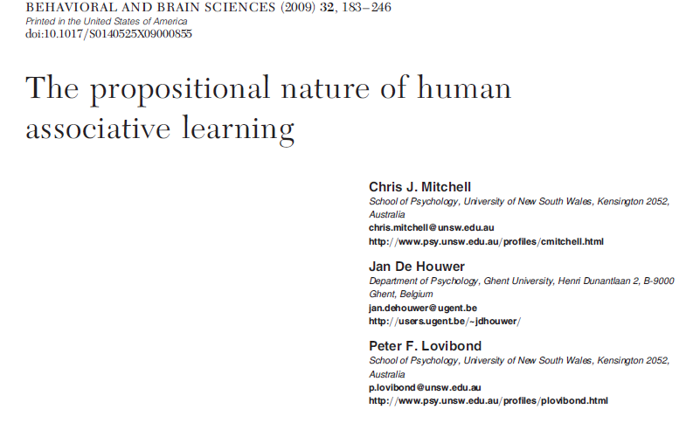

Slide 10
e.g. Pavlov's dog:
Bell
Food
Bell
Food
?? ….
belief:
"Bell predicts
food"!
Bell =>
predict
Food
=> salivation
See VIDEO about belief violation in dogs

Slide 11
II.2.2. General evaluation
(a) Heuristic value
Impact of properties CS, US, intrinsic relationship: Impact via
=> attention
=> motivation
=> hypotheses (knowledge CS-US relationship)

Slide 12
Also, involuntary, irrational behavior
=> in principle many kinds of behavior, also irrational behavior
=> model does not say what behavior (idem for associative models)
First deliberate judgment CS-US relationship
=> because proposition must be conscious
Different organisms
=> not all animals have propositions
=> but some animals do (vb., rats): they use available cognitive skills
VIDEO tool use + problem solving in birds

Slide 13
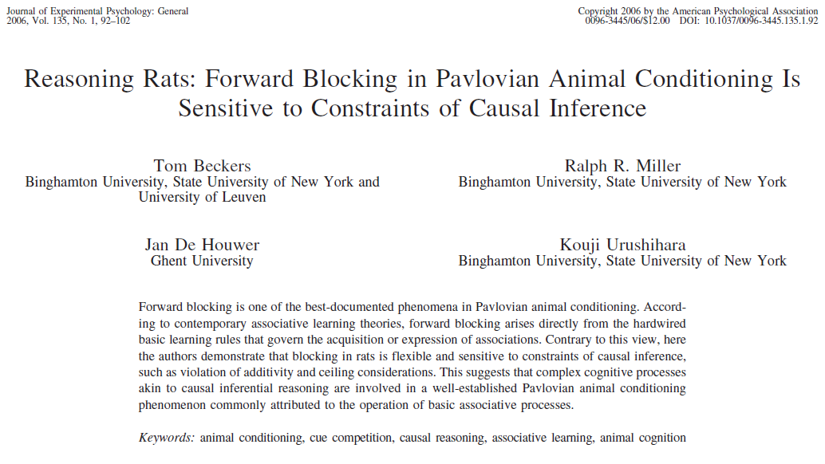

Slide 15
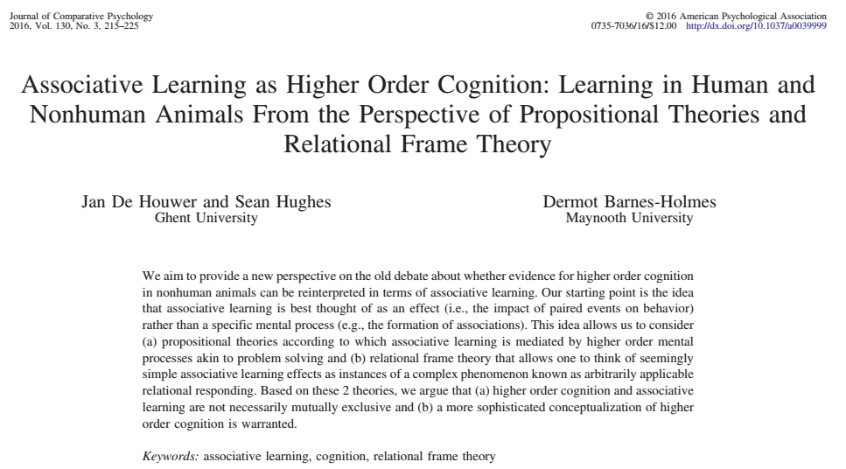

Slide 16
Impact of secondary tasks
=> because attention is needed for problem solving
=> High heuristic value

Slide 17
(b) Predictive value: when to block?
Lettuce: Allergic reaction 10/20
Lettuce + tomato: allergic reaction 10/20
=> allergic to tomato?
Yes
uncertain
No
= blocking: A+, AX+ => no CR for X
Notes:
🍐 This is a Pear Deck Multiple Choice Slide. Your current options are: A: yes, B: uncertain, C: no,
🍐 To edit the type of question or choices, go back to the "Ask Students a Question" in the Pear Deck sidebar.

Slide 18
Lettuce: Allergic reaction 10/10
Lettuce + tomato: allergic reaction 10/10
=> allergic to tomato?
Yes
uncertain
No
= blocking: A+, AX+ => no CR for X
=> Blocking based on propositional reasoning: possibility of deducing whether X adds anything to the effect of A
Notes:
🍐 This is a Pear Deck Multiple Choice Slide. Your current options are: A: yes, B: uncertain, C: no,
🍐 To edit the type of question or choices, go back to the "Ask Students a Question" in the Pear Deck sidebar.

Slide 19
Blocking = deliberate reasoning:
Observation A+ => Premise 1: "A is cause US".
Observation AX+ => Premise 2: "A and X cause US".
Existing knowledge => Premise 3: "2 causes together have more effect than each cause separately".
Conclusion: "X is not a cause because effect AX together is equal to effect A alone"
=> blocking does not occur when Premise 3 is in doubt (e.g., maximum USn, predictors instead of causes; De Houwer et al., 2002)

Slide 20
(c) Criticism
=> empirical: Perruchet effect
= dissociation conscious expectation (decreases as # CS-US increases) vs. conditioned response (increases as # CS-US increases)
=> dual process? Eg. McLaren et al., 2018, QJEP
=> not formulated precisely enough and thus not falsifiable

