Slide 1
CHAPTER III: OPERANT CONDITIONING:
THE EFFECT OF REGULARITIES IN THE PRESENCE OF STIMULI AND BEHAVIOR

Slide 2
III.0. SOME BASIC TERMS AND PROCEDURES
III.0.1. Basic terms
OC = effect of regularities in the presence of stimuli and behavior
III.0.1.1. The three terms contingency
Sd: R - Sr
Example: Light: push lever - food
(but not limited to Skinnerbox)

Slide 3
(a) Sd: discriminant stimuli
descriptive/procedural: discriminates between R-Sr and R-no situations => can be 1 stimulus, series of stimuli, or class of stimuli (e.g., red objects: color is unit/criterion delimiting class)
functional: Sd has impact on behavior due to the fact that it indicates the R-Sr relation
eg. Sd: R-Sr / noSd: R-noSr
=> R more frequent after Sd than without Sd
= Sd FUNCTION (role it has)
=> functional stimulus class: class of stimuli that functions as Sd (e.g., red objects)

Slide 4
b) Sr: result / reinforcer
descriptive/procedural: Outcome of behaviour
=> can refer to one stimulus (food chunks) but also to a series of stimuli (10 chunks, 1 per minute) or class of stimuli (e.g., red chunks)
functional: Sr has impact on behavior because of the R-Sr relation
= Sr FUNCTION (role it has)

Slide 5
(c) R: operant behaviour
descriptive/procedural: behaviour that has an impact on the environment = operation
can refer to a single behaviour (pushing a handle) but also to a series of behaviours (entering a code)
Always class of behavior (response class; e.g., pushing handle) delineated by unit of behavior (= criterion)
Example: lever downward distance; force of pressure; imitation of a species, new behavior => can be complex!
functional: behavior that depends on R-Sr relationship
= operant class (e.g., imitative behavior)

Slide 6
III.0.1.2 Types of operant conditioning
1. Learning
3. Punishment
2. Operante Cond.
4. Reinforcement
5. Avoidance Learning
6. Escape Learning

Slide 7
Claim that change in behavior = type of learning is HYPOTHESIS that needs to be supported
Example. Child stops naughty behavior after being scolded
=> punishment: R-Sr relationship is cause of behavioral change
=> alternative explanation: reaction to scolding
(= 1 stimulus at 1 moment so not learning)

Slide 8
III.0.2. Procedures
III.0.2.1. Separate trials method
(a) Thorndike puzzle box (see figure)
=> cat in the box - pulling the loop -fish
=> every time again (separate trials)
(b) Maze
=> start position - search - food
=> start again every time
= time consuming + only speed as AV

Slide 9
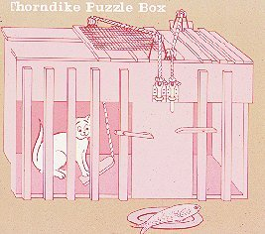

Slide 10
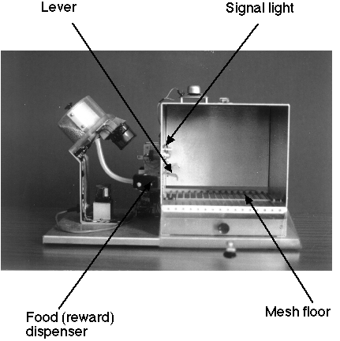
III.0.1.2. Free-operating method
a) Skinner: maze with automatic return of animal to start = efficient + frequency as AV
=> see video + youtube
(b) Skinner box: free to set conduct

Slide 11
Exercise Question 19: In spatial learning studies, rats are placed in a waterreservoir in which a platform is located just below the water surface. The results show that the rats swim towards the platform ever faster. The method used is an example of
(a) a free operant method
(b) a separate trial method
(c) a method of punishment
(d) the importance of intrinsic relationships
( http://www.youtube.com/watch?v=LrCzSIbvSN4 )
Notes:
🍐 This is a Pear Deck Multiple Choice Slide. Your current options are: A: a free operant method, B: a separate trials method, C: a punishment method, D: the importance of intrinsic relationships,
🍐 To edit the type of question or choices, go back to the "Ask Students a Question" in the Pear Deck sidebar.

Slide 12
Exercise Question 20: Take the example of an ice cream man driving his cart around in the summer, pulling a bell each time he enters a new street. If one translates this from the client's perspective in terms of operant conditioning, the sound of the bell is a
(a) Sd
(b) CS
(c) Sr
(d) occasion setter
Notes:
🍐 This is a Pear Deck Multiple Choice Slide. Your current options are: A: Sd, B: CS, C: Sr, D: occasion setter,
🍐 To edit the type of question or choices, go back to the "Ask Students a Question" in the Pear Deck sidebar.

Slide 13
III.1. Functional knowledge
III.1.1. Nature of the stimuli
III.1.1.1. OC is general:
- Different (classes of) stimuli / events
Sd (light, local, ...)
[R (lever push, silence, ...)]
Sr (food, appreciation, ...)
- Illustration: Sensory reinforcement
=> R (e.g., pushing a lever) to get stimulation (e.g., train driving around; repetitive behavior autism)

Slide 14
III.1.1.2. Impact properties Sd, Sr, R-Sr relationship, and Sd-R relationship on the EXTENT of conditioning
(a) (change in) intensity Sd, Sr:
* Better learning as more intense, more relevant
* Change intensity: Punishment more effective if
direct intense Sr (vb., rats - shock; traffic fine) => what is moral?

Slide 15
Freq R
First weak shock
then intense shock
Instant intense shock
R - food
R - food + shock

Slide 16
(b) R-Sr (see role of intrinsic relationship = interaction):
*Seventer: Sticleback
=> faster learning of swimming through ring if it is followed by appearance of female than by male
=> faster learning of biting a bar if it is followed by male than by female
* avoidance learning (behavior reduces likelihood of aversive US)
=> flights very fast (e.g., one way box)
=> pushing the lever very slowly

Slide 17
(c) selectivity in impact Sd-R relationship
* e.g., thermos (red = press)

Slide 18
III.1.1.3. The impact of the nature of the Sr on the NATURE of change in R
=> Nature of change in R = increase or decrease
reinforcement
punishment
(a) Which Sr function as reinforcers?"
Sr is reinforcing if it leads to an increase in behavior
* reinforcer ≠ reward
=> reward implies explanation of why something functions as reinforcer (= mental level) whereas reinforcer = functional level (function)

Slide 19
Thorndike: "Law of effect": Valence Sr matters
=> see youtube video
*reinforcement if R results in positive Sr
(i.e., reinforcement = "reward")
*punishment if R results in negative Sr
But what are pos/neg Sr?
e.g. Masochism: Catania (2013, p. 95) "Masochism is just a name we use when a stimulus that we think should be a punisher serves as a reinforcer; it does not explain anything".

Slide 20
- Hull's " drive " theory: Pos = Satisfy drive
Reinforcement if Sr brings optimal level of drive closer
But: danger circular reasoning (e.g., sensory reinf):
reinforcement drive reduction
This is a (possible) mental explanation, not a description of stimuli that function as reinforcers

Slide 21
- Neuronal explanation: Pos = dopamine production
=> but what if the stimulus that elicits dopamine
functions as punishment?
=> neuroscience can never replace psychology

Slide 22
- Premack: Natural frequency Sr as behavior
*Sr=behavior (e.g., eating)
*behaviors differ in natural freq.
(= how often if no restrictions)
*reinforcement if nat. freq Sr > nat. freq R
e.g. pushing a handle => eating
(i.e., doing something for something you "prefer")
*application: not looking for stimuli (e.g., candy) but behavior (e.g., watching TV)

Slide 23
- Response deprivation: Natural and situational frequency of Sr
* limits on frequency Sr by situation (e.g., no food available; going to a bar)
Sr = reinforcer is situational frequency < natural freq
=> to be able to "do it" less than you "want to do it"
Eg. food is Sr if there is no food but not if there is a lot of food
=> test: R - a lot of food: no increase in R
* punishment: compulsory execution of Sr (e.g., forced labor): situational freq Sr > natural freq.

Slide 24
But ... how to establish natural and situational frequency?
Conclusion: You cannot be 100% sure beforehand whether a stimulus will FUNCTION as a reinforcer or as a punishment.
- always weigh R and Sr (as behaviour)
- always dependent on the situation = contextualism
=> best predictor is effect in the past
=> study impact of moderators

Slide 25
(b) changes in characteristics Sr: Sr revaluation
* Phase 1:
lever => food
chain => sugar water
* Phase 2:
food or sugar water - nausea
* Test:
less lever if food bad
less chain if water bad

Slide 26
Exercise Question 21: Which concept belongs at the functional level?
law-of-effect
remuneration
need
ratification
Notes:
🍐 This is a Pear Deck Multiple Choice Slide. Your current options are: A: law-of-effect, B: reward, C: need, D: empowerment,
🍐 To edit the type of question or choices, go back to the "Ask Students a Question" in the Pear Deck sidebar.

Slide 27
Exercise Question 22: Which expression was first used within Premack's principle?
Natural frequency of behaviour
Situational frequency of behaviour
Reinforcement
Drive
Notes:
🍐 This is a Pear Deck Multiple Choice Slide. Your current options are: A: natural frequency of behavior, B: situational frequency of behavior, C: reinforcement, D: drive,
🍐 To edit the type of question or choices, go back to the "Ask Students a Question" in the Pear Deck sidebar.

Slide 28
Overview:
0. Introduction
I. Effects of non-contingent stimulus presentations
II. Classical conditioning
III. Operant conditioning
III.0. Some basic terms and procedures
III.1. Functional knowledge
III.1.1. Nature of the stimuli
1. OC is a general phenomenon
2. influence of stimuli on MATE of conditioning
3. influence of Sr on nature of conditioning
III.1.2. Nature of behavior

Slide 29
III.1.2. Nature of the observed behaviour
III.1.2.1. Influence on voluntary and involuntary behaviour?
- indirectly (through voluntary behavior)
=> example: heartbeat - money
- directly (without voluntary behavior)
=> Miller: Heartbeat – brain stimulation (curare)
=> difficult to replicate
=> biofeedback: control of autonomy
reactions via (pos.) feedback about those reactions (e.g., blood pressure, ADHD, brain activity): but " really " indirectly?

Slide 30
III.1.2.2. Nature of change in behavior
(a) various aspects of existing behavior
* frequency
* strength
* creativity
* speed
=> unit of behavior is crucial
R = operative CLASS
WHAT is being reinforced (what is the unit)?:
E.g. New ways of pressing vs. pressing
E.g. Press intermittently vs. pressing

Slide 31
b) creating new behaviour: Shaping
* often sequence is new (e.g., lever pressing)
=> see youtube video
* also completely new behaviour via systematic changes in the unit of behaviour

Slide 32
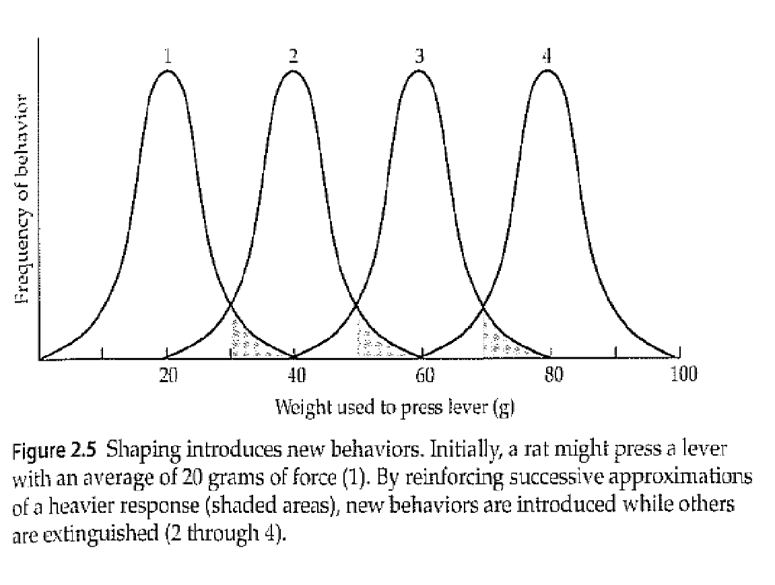

Slide 33
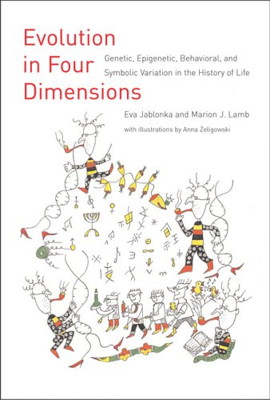
*Shaping in everyday life:
eg. Learning to drive a bicycle
(pedalling, steering, balance)
* Shaping as ontogenetic evolution of behaviour: variability is crucial

Slide 34
c) Consistency between different changes in behaviour
- Unconscious OC: verbal conditioning
* plural - "uhhum"
*unaware of connection
- Criticism: Correlated contingencies
*Example: talk about jewels (diamonds, rubies)
*Awareness test must examine ALL possible relevant knowledge (not just intended rule)
= "information criterion"
- Importance of "consciousness" aligns with Skinner distinction rule-governed vs contingency-based

Slide 36
III.1.3. Characteristics of organism
- general: rats, humans, fruit flies (genes)
- intrinsic relationships: genes may be important
III.1.4. Influence of the broader context
III.1.4.1. Other Sd:R-Sr relations - each behaviour is a choice: also outcomes of other behaviour are important
- DRO: reinforce behaviors that are incompatible with undesirable behaviors (e.g., mutation vs. sitting still)
- DOE: unique outcomes have more impact
=> way to improve learning

Slide 37
Example DOE:
Condition 1:
Sd R Sr
light : press lever => brown food pellet
tone : pull chain => brown food pellet
Condition 2:
Sd R Sr
light : press lever => brown food pellet
tone : pull chain => white food pellet
=> better learning in condition 2

Slide 38
III.1.4.2. Sr establishing operations
=> Context influences how Sr functions as a reinforcer ("motivation")
Example. Food deprivation: establishes Sr function
=> Not only innate but also learned
e.g. Via pairing of stimuli (e.g., smell of coffee)
=> Retrospective effect (impact old R-Sr relations)
or prospective effect (impact of new R-Sr relationships)

Slide 39
=> Sd versus Sr estalishing
Sd = when is there R-Sr relationship
(e.g. flashlight indicator light)
Sr-establishing = what is impact of R-Sr relationship
(e.g. dark room)
but Sd can also establish Sr.
(e.g., light: pushing - food)
distinguish procedure/description versus effect/function!

Slide 40
