Slide 1
Course Overview:
0. Introductory chapter:
I. Effects of non-contingent stimulus presentations
II. Classical conditioning
III. Operant conditioning
III.0. Some basic terms and procedures
III.1. Functional knowledge
III.2. Mental process theories
IV. Complex learning
V. Applied Learning Psychology

Slide 2
III.2 Process theories
Objective: To explain procedural knowledge about OC
Two types:
1. Associative models:
*S-R
*R - Sr, Sd - Sr
2. Propositional models

Slide 3
III.2.1. Associative models
- Effect of Sd: effect of R-Sr regularities on behavior is mediated by associations
regularity ===> association ===> change in behavior
- 2 types of associations:
S - R
R-Sr and Sd-Sr

Slide 4
III.2.1.1. S-R models
(a) The core of S-R models
1. Not learning about Sr, but because of Sr
Sd R Sr
2. Why?: Try to avoid R-Sr (teleological) explanation because " real " causes of behavior must be present here and now => only Sd can be cause of R (Sr is there only after R)
= mechanistic S-R view (contiguous causation vs. functional causation)

Slide 5
(b) example: two-factor model by Mowrer
- escape and avoidance learning: R leads to absence negative Sr
=> results in reinforcement (increase freq. R)
=> concrete example: shuttle box: if light, then shock
- first escape as shock
- than avoidance when light turns on

Slide 6
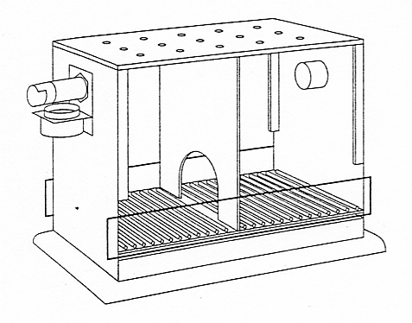

Example shuttle-box
warning light
door
2 separate
rooms
(Variant: one-way box: 1 place is always safe)

Slide 7
- but how can absence of Sr have an effect?
=> is problem for S-R because presence
Sr is needed to strengthen S-R relationship
=> with escape there is Sr (stopping something negative)
=> when avoiding there is no Sr: should result in
extinction

Slide 8
- Mowrer: 2 factors theory of avoidance learning
* During escape:
° light-run association reinforced by stopping of shock = S-R view on OC with pain reduction as Sr
° light-fear association is strengthened by the co-occurrence of light and fear (elicited by shock)
= S-R view on classical conditioning (CC)
* During avoidance:
° light-run association strengthened by stopping of conditioned fear of light
= S-R vision OC with fear reduction as Sr
=> because of CC there is a reinforcing element (Sr) during avoidance (i.e., fear reduction as Sr)

Slide 9
Essence: Due to CC stopping fear takes over the function of the Sr as a source of reinforcement
Initially: Escape
(light) (shock) (end of shock)
CS US (+UR) R Sr
Eventually: Avoidance
(light) (fear) (fear stops)
CS CR R Sr
Due to end of
Sr, CS-R association becomes stronger
CS-fear asso as a result of prior
CS-US pairing
As a result of Sr (fear stops)
CS-R asso becomes stronger

Slide 10
(continuing) success 2 factors model: stopping fear as a source of reinforcement => “fear of fear”
* problems 2 factors model
° conditioned fear should extinguish and therefore also avoidance behavior should extinguish
=> stopping fear as Sr is only a partial solution
° problems with S-R view on CC
(e.g., CR differs from UR: e.g., fear vs. pain)

Slide 11
c) General evaluation S-R models: Different aspects of procedural knowledge cannot be explained:
e.g. Effect of changes in Sr
Colwill & Rescorla: Sr evaluation has effect
=> Sr representation mediates OC
McFarlane: Swimming or walking for food
=> not learning motor R
=> can learn unit "approach food"
but sometimes no effect Sr revaluation:
HABITS after much practice
ACTION vs HABITS (Dickinson)
[Note: habits = no effect Sr revaluation => is difficult to establishe habits]

Slide 12
Exercise Question 34: According to S-R models of operant conditioning, what is the function of the Sd?
To elicit a behavior.
To indicate when R is followed by Sr.
To influence the activity of exitatory R-Sr associations.
To reinforce S-R associations
Notes:
🍐 This is a Pear Deck Multiple Choice Slide. Your current options are: A: To elicit a behavior, B: To indicate when R is followed by Sr, C: To influence the activity of exitatory R-Sr associations, D: Reinforcing S-R associations,
🍐 To edit the type of question or choices, go back to the "Ask Students a Question" in the Pear Deck sidebar.

Slide 13
Overview:
0. Introduction
I. Effects of non-contingent stimulus presentations
II. Classical conditioning
III. Operant conditioning
III.0. Some basic terms and procedures
III.1. Functional knowledge
III.2. Mental Process Theories
III.2.1. Associative models
III.2.1.1. S-R models
III.2.1.2. R-Sr and Sd-Sr models
III.2.2. Propositional models

Slide 14
III.2.1.2. R-Sr and Sd-Sr models: learning about Sr
(a) The core of R-Sr models
- Sr determines behaviour: behaviour is directed at obtaining Sr
- OC is mediated by R-Sr association: activation Sr activates R (see next page = "ideomotor theory")
- but detailed R-Sr models are lacking
* study CC is easier at practical level
* idea that formation R-Sr = formation S-S
=> more research on CC than on OC
- but R-Sr is not enough: see role Sd

Slide 15
R-Sr model without Sd
Past:
Repeated R - Sr
Environment: Sr
R--------Sr
behaviour

Slide 16
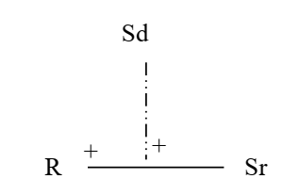
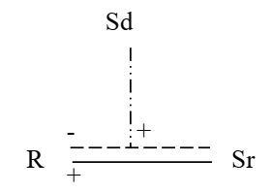
How can Sd have influence in R-Sr model?
- Context dependent R-Sr associations
* "feature positive"
* "feature negative"
(Note: + and - on side of R)

Slide 17

- Formation of Sd-Sr associations
=> impact Sd via activation Sr:
see indirect Sd-R relationship
Fase 1: tone: nose push -food
Fase 2: lever press - food
Test: tone increases probability of nose push
Thinking => Action (see Ideomotor theory)

Slide 18
Past:
Repeatedly R - Sr and Sd -Sr
Sd
R Sr
Environment: Sd
behaviour

Slide 19

- Dickinson (2012): Combining Sd-R and R-Sr
E.g. seeing lever reminds of pressing lever which reminds of (tasty) food which reminds of pressing lever even more
= combination of habit (strong Sd-R) and goal-directed behaviour (strong R-Sr: push to get food)

Slide 20
Exercise Question 35: What function does the Sd have according to R-Sr models of operant conditioning in which Sd-Sr associations are postulated?
To activate the R representation directly.
To indicate when R is followed by Sr.
To indirectly activate the R representation.
To strengthen R-Sr associations.
Notes:
🍐 This is a Pear Deck Multiple Choice Slide. Your current options are: A: Activating the R representation directly, B: Indicating when R is followed by Sr, C: Activating the R representation indirectly, D: To enhance R-Sr associations,
🍐 To edit the type of question or choices, go back to the "Ask Students a Question" in the Pear Deck sidebar.

Slide 21
III.2.2. Propositional models
III.2.2.1. The core of propositional models
- formulate and test hypotheses about the effects of behavior (see VIDEO )
- behavior depends on propositions about R-Sr relations that are believed to be true
- E.g. Lovibond (2006; Declercq & De Houwer, 2009)
Propositional explanation of avoidance learning
(1) “When in room A (Sd), a shock will come"
(2) "Shock doesn't come when I run to room B"
=> Conclusion: run to room B

Slide 22
Example shuttle-box
warning light
door
2 separate
spaces
(Variant: one-way box: 1 place is always safe)

Slide 23
III.2.2.2. General evaluation of propositional models
- OC is about causal learning:
Watson study: more fun if movement object depends on own behaviour => babies are able to see causal connection (also see video on causal reasoning and tool use in crows)
Learning about the nature of the relation is important (see AARR) => can only be done in propositional models
(see video MTS in dogs / NAARR)

Slide 26
- irrational behavior: can be explained by a propositional model in different ways
1: faulty propositions that arise from incorrect sampling or incorrect information
2: faulty reasoning
3: Automatic effects of old propositions: Once proposition is formed, influence can be automatic
=> irrationality can arise from a rational system

Slide 27
Box 3.5: Is reinforcement desirable?
a) possible negative impact on 'intrinsic' motivation
* e.g.: “rewarding” drawing, studying, …
* Experiment
- Fase 1: puzzles without money
- Fase 2: puzzles without or with money
- Fase 3: puzzles without money
=> less puzzles if money is provided in Fase 2
=> " a reward a day makes work out of play "

Slide 28
b) But no contradiction Self-Determination-Theory (SDT) versus operant conditioning
OC / reinforcement = effect
=> if R-Sr relation leads to an increase in freq. R, then this is by definition reinforcement / OC
=> Sr is reinforcing if R-Sr relation leads to an increase in frequency R = empirical questions
=> but R-Sr relation will not always lead to increase (e.g., context: food is punishment if already eaten too much): reward is not the same as reinforcer
SDT = theory / mental process explanation
=> explains and makes predictions about reinforcement (when R-Sr relationship leads to increase in frequency of R)

Slide 29
Functional-cognitive framework:
Different approaches are possible
both of which have their value
and can strengthen each other
"The naming of a stimulus as a reinforcer does not say why the stimulus has that function, but it does say that it has that function, which is also an important thing to know.."
(p. 179)

